Slide 1
iOS Application (In)Security
OWASP: Google Ireland
March 2012

Slide 2
Introduction
Company and Speaker Overview
I’m a co-founder & director of MDSec
Apple fanboy?
CVE-2011-0204: Apple ImageIO TIFF Heap Overflow CVE-2011-0194: Apple ImageIO TIFF Image Integer Overflow CVE-2010-1845: Apple ImageIO PSD Memory Corruption
Perspective is that of a Pen tester, not a developer
MDSec:
Web App Hacker’s Handbook 1st & 2nd Edition
Worldwide training
Online training
Burp Suite
1999
2004
2007
2011
2013

Slide 3
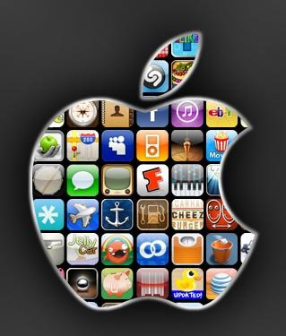
iOS Applications (In)Security
Overview
Introduction
Overview of iOS & Apps
Blackbox Assessment
Transport Security
Data Storage
Keychain
Protocol Handlers
UIWebViews
Injection Attacks
Filesystem Interaction
Geolocation
Logging
Memory Corruption

Slide 4
Overview
Why Mobile Security?
Mobile Security
In focus over last few years
Steady increase in requests for mobile app assessments
Public app problems:
Citigroup data storage
Skype XSS & Protocol Handler vulnerabilities
Often hold personal data
Online banking, social networking etc…
Why iOS Apps?
Apple have a 52% market share [1]
Over half a million apps in App Store
http://www.netmarketshare.com/operating-system-market-share.aspx?qprid=9&qpcustomb=1

Slide 5
Overview
Why Mobile Security?
“In a letter, the US banking giant said the Citi Mobile app saved user information in a hidden file that could be used by attackers to gain unauthorized access to online accounts. Personal information stored in the file could include account numbers, bill payments and security access codes…”.
http://www.theregister.co.uk/2010/07/27/citi_iphone_app_weakness/

Slide 6
Overview
Platform Security Features
Code Signing
Prevents unauthorised apps running
Validates app signatures at runtime
Sandboxing
Apps run in a self-contained environment
Third party apps assigned “container” seatbelt profile
Allows some access to address book, media & outbound network
ASLR
Randomises where data & code is mapped in an address space
Apps can have partial or full ASLR (compiled with PIE)
Encryption
Hardware based encryption; “data is encrypted at rest”
Provides Data Protection API for protecting individual items

Slide 7
Overview
iOS Apps
Developed in Objective C
Superset of C
Xcode for development
I can haz Apple?
NSAutoreleasePool *pool = [[NSAutoreleasePool alloc] init];
NSLog (@"Hello, World!");
[pool drain];

Slide 8
Overview
iOS Apps
Previous work:
“Auditing iPhone and iPad Applications” by Ilja van Sprundel
“Secure Development on iOS” by David Thiel
“Apple iOS 4 Security Evaluation” by Dino Dai Zovi

Slide 9
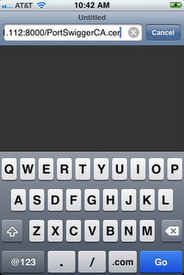
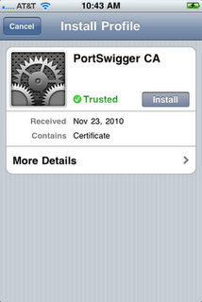
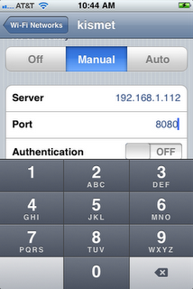
Blackbox Assessment
Intercepting Communications
Configure the device for a proxy
Install a self-signed certificate on the device to capture HTTPS
http://carnal0wnage.attackresearch.com/2010/11/iphone-burp.html

Slide 10
Blackbox Assessment
Reverse Engineering
Apps are stored as an IPA in iTunes Library
IPA is just ZIP
App Store binaries are encrypted
Manual decryption
Use debugger, breakpoint EP, let loader decrypt, dump decrypted image
http://dvlabs.tippingpoint.com/blog/2009/03/06/reverse-engineering-iphone-appstore-binaries
Automated
Crackulous & AppCrack

Slide 11
Blackbox Assessment
Reverse Engineering
LC_ENCRYPTION_INFO:

Slide 12
Blackbox Assessment
Reverse Engineering
Manual decryption of an AppStore Binary:
Take cryptsize from LC_ENCRYPTION_INFO
Breakpoint doModInitFunctions
Dump memory from start address to start address + cryptsize
# gdb --quiet -e ./99Bottles
Reading symbols for shared libraries . done
(gdb) set sharedlibrary load-rules ".*" ".*" none
(gdb) set inferior-auto-start-dyld off
(gdb) set sharedlibrary preload-libraries off
(gdb) rb doModInitFunctions
Breakpoint 1 at 0x2fe0ce36
<function, no debug info> __dyld__ZN16ImageLoaderMachO18doModInitFunctionsERKN11ImageLoader11LinkContextE;
(gdb) r
Starting program: /private/var/mobile/Applications/E938B6D0-9ADE-4CD6-83B8-712D0549426D/99Bottles.app/99Bottles
Breakpoint 1, 0x2fe0ce36 in __dyld__ZN16ImageLoaderMachO18doModInitFunctionsERKN11ImageLoader11LinkContextE ()
(gdb) dump memory 99bottles.dec 0x2000 (0x2000 + 0x3000)

Slide 13
Blackbox Assessment
Position Independent Executable
Use a jailbroken phone to SSH to the device and extract the app
Otool is your friend
With PIE:
Without PIE:

Slide 14
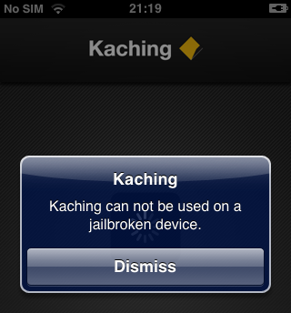
Blackbox Assessment
Inspecting the binary
Wealth of information in the __OBJC segment
Internal classes, methods and variables
Parse using class-dump-z
Snippet from CommBank Kaching App:
@interface RootViewController : /private/tmp/KIA_IPHONE_SOURCE/ <UIWebViewDelegate, DILDisplayView, UIAlertViewDelegate>
{
<snip>
- (BOOL)isJailbrokenDevice;

Slide 15
Blackbox Assessment
Hooking the runtime
The runtime can be hooked using MobileSubstrate
Hook Objective-C, C or C++
CaptainHook provides API for MobileSubstrate
Allows access to internals of app
CHOptimizedMethod(0, self, BOOL, RootViewController, isJailbrokenDevice)
{
NSLog(@"####### isJailbrokenDevice hooked");
return false;
}

Slide 16
Blackbox Assessment
Hooking the runtime
DEMO

Slide 17
Transport Security
Introduction
Mobile devices may often use untrusted networks
Imperative that data is sent securely
Apple provides a couple of ways to do HTTPS
NSURLConnection
CFNetwork
Developers sometimes pass on to third party code
CyaSSL
Matrix SSL
OpenSSL

Slide 18
Transport Security
SSL Ciphers
Different TLS handshake depending on SDK
Version 4.3 of SDK uses TLS 1.0 with 29 suites, some weak:
TLS_RSA_WITH_DES_CBC_SHA
TLS_RSA_EXPORT_WITH_RC4_MD5
TLS_RSA_EXPORT_WITH_DES40_CBC_SHA
TLS_DHE_RSA_WITH_DES_CBC_SHA
TLS_DHE_RSA_EXPORT_WITH_DES40_CBC_SHA
Version 5.0 uses TLS 1.2 with 37 suites, none weak
API provides no way to configure cipher suites AFAIK

Slide 19
Transport Security
NSURLConnection
Developers often allow self-signed certs
NSURLRequest:
Default behaviour is to reject cert and throw NSURLErrorDomain
Developers override with allowsAnyHTTPSCertificateForHost
Private delegate method
NSURLConnection:
Alternate approach using didReceiveAuthenticationChallenge delegate
Ignore cert using continueWithoutCredentialForAuthenticationChallenge selector

Slide 20
Transport Security
CFNetwork
Alternate API implementation
More granular than NSURLConnection
Developers have more control over certs
Allow expired certs:
kCFStreamSSLAllowsExpiredCertificates
Allow expired roots:
kCFStreamSSLAllowsExpiredRoots
Allow any root:
kCFStreamSSLAllowsAnyRoot
No validation at all????
: kCFStreamSSLValidatesCertificateChain

Slide 21
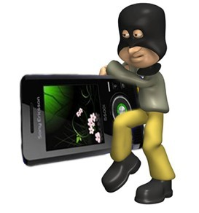
Data Storage
Introduction
Mobile apps can often hold sensitive data
High risk of device being lost or stolen
Imperative data is protected in these scenarios
Client-side data takes a number of forms
Custom created documents
Logs
Cookie stores
Plists
Data caches
Databases
Stored in /var/mobile/Applications/<GUID>

Slide 22
Data Storage
Data Protection API
Apple API for using the hardware crypto
Encrypted using a key derived from passcode
Developers must “mark” files to protect
4 levels of protection
No protection:
NSDataWritingFileProtectionNone / NSFileProtectionNone
Complete protection:
NSDataWritingFileProtectionComplete / NSFileProtectionComplete
Complete unless open:
NSDataWritingFileProtectionCompleteUnlessOpen / NSFileProtectionCompleteUnlessOpen
Complete until first authentication:
NSDataWritingFileProtectionCompleteUntilFirstUserAuthentication / NSFileProtectionCompleteUntilFirstUserAuthentication

Slide 23
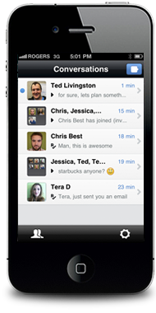
Data Storage
Real World Example
Kik Messenger
Send IM through data
Over 1 million users
Users sign up for a Kik account
http://kik.com/

Slide 24
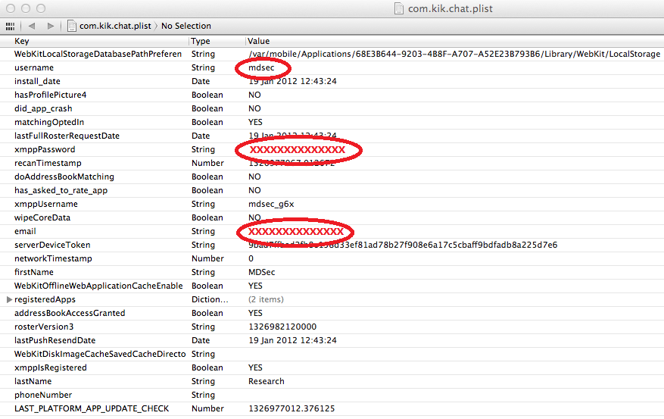
Data Storage
Kik Messenger
Library/Preferences/com.kik.chat.plist:
Username
Password
Email

Slide 25
Data Storage
Kik Messenger
Documents/kik.sqlite:
Chat history

Slide 26
Data Storage
Kik Messenger
Documents/fileAttachments:
mbp:Documents $ file fileAttachments/057a8fc9-0daf-4750-b356-5b28755f4ec4
fileAttachments/057a8fc9-0daf-4750-b356-5b28755f4ec4: JPEG image data, JFIF standard 1.01 mbp:Documents $

Slide 27
Keychain
Overview
Encrypted container for storing sensitive information
Apps can only access their keychain items unless part of a keychain access group:
Set by entitlements from provisioning profile
Jailbroken – apps to dump keychain
6 levels of protection with Data Protection API:
kSecAttrAccessibleAlways
kSecAttrAccessibleWhenUnlocked
kSecAttrAccessibleAfterFirstUnlock
kSecAttrAccessibleAlwaysThisDeviceOnly
kSecAttrAccessibleWhenUnlockedThisDeviceOnly
kSecAttrAccessibleAfterFirstUnlockThisDeviceOnly

Slide 28
Protocol Handlers
Overview
No real Inter-Process Communication
Apps prohibited from sharing because of sandbox
Apps sometimes need to share data
Apps can register a custom protocol handler

Slide 29
Protocol Handlers
Implementation
Two methods for implementing protocol handlers
handleOpenURL
Now deprecated
openURL
Provides bundle identifier
Allows developer to validate source app
Example found during an app assessment
app://setConfiguration?landingpage= - Set the landing page for an app

Slide 30
Protocol Handlers
Skype Vulnerability
Skype registers the “skype://” protocol handler
Malicious web site could make calls
Skype app did not prompt or validate before call
<iframe src=”skype://123456789?call"></iframe>
https://media.blackhat.com/bh-eu-11/Nitesh_Dhanjani/BlackHat_EU_2011_Dhanjani_Attacks_Against_Apples_iOS-WP.pdf

Slide 31
UIWebViews
Overview
iOS rendering engine for displaying text, supports a number of formats:
HTML
PDF
RTF
Office Documents (XLS, PPT, DOC)
iWork Documents (Pages, Numbers, Keynote)
Built upon WebKit and uses the same core frameworks as Safari
Supports java-script, cannot be disabled
Unescaped input leads to Cross-Site Scripting

Slide 32
UIWebView
Cross-Site Scripting
Similar attacks to standard XSS
Session theft etc
Can occur whenever user controlled Objective C variables populated in to WebView
stringByEvaluatingJavaScriptFromString
NSString *javascript = [[NSString alloc] initWithFormat:@"var myvar=\"%@\";", username];
[mywebView stringByEvaluatingJavaScriptFromString:javascript];

Slide 33
UIWebView
Cross-Site Scripting
No native JS to Objective C bridge
Developers will often implement one
Examples:
Using camera from JS
Sending e-mails from JS
Sending SMS from JS
Bridge implemented using WebView specific URL handler:
shouldStartLoadWithRequest
Bridge can often expose Objective C methods
Serialize/Unserialize methods & parameters
performSelector:NSSelectorFromString(method)

Slide 34
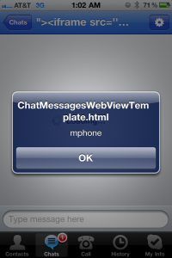
UIWebView
Cross-Site Scripting
Real world example:
Skype (AGAIN!)
Displays “full name” from incoming call in a WebView
Used a local HTML template so loaded in local context
XSS in full name lead to addressbook theft
https://superevr.com/blog/2011/xss-in-skype-for-ios/

Slide 35
XML Processing
Overview
Widely used in mobile apps
iOS offers 2 options for parsing XML with the SDK:
NSXMLParser
libXML2
Lots of other third party implementations exist

Slide 36
XML Processing
NSXMLParser
Not vulnerable to “billion laughs” attack by default
Parser raises a NSXMLParserEntityRefLoopError exception
Not vulnerable to eXternal Xml Entity injection by default
Developer must enable the setShouldResolveExternalEntities option
Not unthinkable, seen in practice on several occasions
NSXMLParser *addressParser = [[NSXMLParser alloc] initWithData:xmlData];
[addressParser setShouldResolveExternalEntities:YES];

Slide 37
XML Processing
libXML2
Not vulnerable to “billion laughs” attack by default
Parser throws error: “Detected an entity reference loop”
Vulnerable to eXternal XML Entity injection by default!
-(BOOL) parser:(NSString *)xml {
xmlDocPtr doc = xmlParseMemory([xml UTF8String], [xml lengthOfBytesUsingEncoding:NSUTF8StringEncoding]);
xmlNodePtr root = xmlDocGetRootElement(doc);
}

Slide 38
SQL
Overview
Apps may need to store data client-side
API supports SQLite
Unsanitised user input in dynamic queries leads to SQL injection
Used parameterised queries!
NSString *sql = [NSString stringWithFormat:@"SELECT name FROM products WHERE id = '%@'", id];
const char *query = [sql UTF8String];
const char *sql = "SELECT name FROM products WHERE id = ?";
sqlite3_prepare_v2(database, sql, -1, &sql_statement, NULL);
sqlite3_bind_text(&sql_statement, 1, id, -1, SQLITE_TRANSIENT);

Slide 39
SQL
Demo
NSString *sql = [NSString stringWithFormat:@"INSERT INTO tweets VALUES('1', '%@','%@','%@')", tweet, user, displayname];
const char *insert_stmt = [sql UTF8String];
sqlite3_prepare_v2(database, insert_stmt, -1, &statement, NULL);
if (sqlite3_step(statement) == SQLITE_DONE)
DEMO

Slide 40
Filesystem Interaction
Overview
Objective C provides NSFileManager class for filesystem access:
Check if file exists
Compare file contents
Check file permissions
Move/Copy files
Read & write from/to files
Can be affected by traditional file IO issues

Slide 41
Filesystem Interaction
Directory Traversal
Vulnerable to vanilla traversals:
../../../../../../../
NSString *fname = @"../Documents/secret.txt";
NSString *sourcePath = [[NSString alloc] initWithFormat:@"%@/%@", [[NSBundle mainBundle] resourcePath], fname];
NSString *contents = [[NSString alloc] initWithData:[fm readContents:sourcePath] encoding:NSUTF8StringEncoding];
- (NSData*) readContents:(NSString*)location {
NSFileManager *filemgr;
NSData *buffer;
filemgr = [NSFileManager defaultManager];
buffer = [filemgr contentsAtPath:location];
return buffer;
}

Slide 42
Filesystem Interaction
Poison Null Byte Attacks
NSString does not use null bytes to terminate strings
Creates problems if used with C file operations
May allow early termination for bypasses
NSString *fname = @"../Documents/secret.txt\0";
NSString *sourcePath = [[NSString alloc] initWithFormat:@"%@/%@.jpg", [[NSBundle mainBundle] resourcePath], fname];
char line[1024];
FILE *fp = fopen([sourcePath UTF8String], "r");

Slide 43
Logging
Overview
API provides the NSLog() method
Will print to console log
Visible in Xcode Organiser
Logs cached until reboot
Can be read by any iOS app using Apple System Log (ASL) lib
Some jailbreaks redirect console > syslog
Some apps will use their own wrapper and log to app folder
Don’t store sensitive information there!
If used, ensure removed in release builds – use a pre-processor macro
NSLog(@"Account Number: %@, Sort code: %@", account, sortcode);

Slide 44
Geolocation
Overview
Provided by the Core Location framework
Avoid being “too accurate”
Don’t log location information on either client or server
If you MUST – make anonymous!

Slide 45
Geolocation
Accuracy
Can be set by one of the following constants:
kCLLocationAccuracyBestForNavigation; kCLLocationAccuracyBest; kCLLocationAccuracyNearestTenMeters; kCLLocationAccuracyHundredMeters; kCLLocationAccuracyKilometer; kCLLocationAccuracyThreeKilometers;
self.locationManager.desiredAccuracy = kCLLocationAccuracyBest;

Slide 46
State Transitions
Backgrounding
Application might change state, enter background if:
Incoming call
User hits home button
To streamline the transition, iOS takes a snapshot of current view
Used to give the impression of “instant” loading
Stored on the file system in clear text
May contain sensitive data
- (void)applicationDidEnterBackground:(UIApplication *)application {
viewController.creditcardNumber.hidden = YES;
}

Slide 47
Memory Corruption
Overview
As previously mentioned – superset of C
Developers often using straight C
Compiled to native code
Gives rise to the traditional issues
Overflows
Integer wraps
Shouldn’t need to allocate memory unless specific performance overhead
Stick to objective C allocators

Slide 48
Memory Corruption
Format Strings
A number of API methods support format specifiers
If used incorrectly, leads to classic format string bugs
Vulnerable methods include:
NSLog()
[NSString stringWithFormat]
[NSString stringByAppendingFormat]
[NSString initWithFormat]
[NSMutableString appendFormat]
[NSAlert alertWithMessageText]
[NSException]

Slide 49
Memory Corruption
Format Strings - Exploitation
Traditionally use %n to write to an arbitrary address
Not available on iOS
Apple provide %@ specifier for objects
Call an arbitrary function pointer!
Unfortunately rare to find data stored on stack ☹

Slide 50
Memory Corruption
Format Strings - Exploitation
Example:
NSString *myURL=@"http://localhost/test";
NSURLRequest *theRequest = [NSURLRequest requestWithURL:[NSURL
URLWithString:myURL]];
NSURLResponse *resp = nil;
NSError *err = nil;
NSData *response = [NSURLConnection sendSynchronousRequest: theRequest returningResponse: &resp error: &err];
NSString * theString = [[NSString alloc] initWithData:response encoding:NSASCIIStringEncoding];
NSLog(theString);

Slide 51
Memory Corruption
Format Strings - Exploitation
Example:
Output:
Dumps stack memory
HTTP/1.1 200 OK
Content-Length: 29
AAAA%08x.%08x.%08x.%08x.%08x.
2012-01-31 17:46:41.780 fmtstr[2476:1207] AAAA93f9ea22.0030fc90.00000001.bffffbf8.00000000.

Slide 52
Memory Corruption
Object Use after Free
Same concept as use-after-free bugs
References to an object still exist after it has been freed
Exploitable but unlikely in practice
Some protection offered by Automatic Reference Counting (ARC)
MDSec *mdsec = [[MDSec alloc] init];
[mdsec release];
[mdsec echo: @"MDSec!"];

Slide 53
Conclusions
Transport security & data storage are probably two of the biggest issues for iOS apps
Apps can be vulnerable to lots of API specific attacks
Platform provides additional security features to mitigate against some attacks

Slide 54
Q & A
That’s all folks!
QUESTIONS?
Online:
http://www.mdsec.co.uk
http://blog.mdsec.co.uk
E-Mail:
dominic [at] mdsec [dot] co [dot] uk
Twitter:
@deadbeefuk
@MDSecLabs

