Slide 1
iOS Debugging PART I
Finding and eliminating bugs in the code is a critical phase of the development process.
Dawid Planeta Technology Development Thomson Reuters
London, August 2013

Slide 2
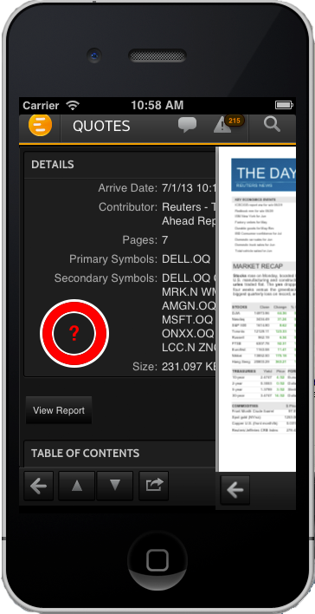
Question
What type is clicked object?
Imagine that you are new to the project and you want to quickly know the name of a selected class.
How to do this using debugger?
"Everybody knows that something can't be done and then somebody turns up and he doesn't know it can't be done and
he does it."

Slide 3
Question
1.) What type is clicked object?
How to find the answer? Where and what kind breakpoint to create?
(lldb) breakpoint set --name "-[UIResponder touchesEnded:withEvent:]"
(lldb) breakpoint set --name "-[UIWindow sendEvent:]” (lldb) breakpoint set --selector touchesEnded:withEvent:
Check breakpoint list.
(lldb) breakpoint list
?
name vs selector differents?
Let’s check what is going on in the code. Look at (opcode) assembly instructions.
Assembly language, or just assembly, is a low-level programming language, which uses mnemonics, instructions and operands to represent machine code.

Slide 4
Question
(lldb) breakpoint set --name "-[UIResponder touchesEnded:withEvent:]"
Breakpoint 2: where = UIKit`-[UIResponder touchesEnded:withEvent:], address = 0x02cc898e
(lldb) disassemble --frame
UIKit`-[UIResponder touchesEnded:withEvent:]:
-> 0x2cc898e: pushl %ebp
0x2cc898f: movl %esp, %ebp
0x2cc8991: subl $8, %esp
0x2cc8994: movl 20(%ebp), %eax
0x2cc8997: movl %eax, 4(%esp)
0x2cc899b: movl 16(%ebp), %eax
0x2cc899e: movl %eax, (%esp)
0x2cc89a1: movl 8(%ebp), %ecx
0x2cc89a4: movl 12(%ebp), %edx
0x2cc89a7: calll 0x2cc882d ; forwardTouchMethod
0x2cc89ac: addl $8, %esp
0x2cc89af: popl %ebp
0x2cc89b0: ret
(lldb)
Example:
push ebp
copy stack pointer to ebp
make space on stack for local data
ebp -- used to access data on stack
opcode source, dest

Slide 5
Question
EAX - Accumulator Register
EBX - Base Register (for use with arrays)
ECX - Counter Register
EDX - Data Register
ESI - Source Index
EDI - Destination Index
EBP - Base Pointer
ESP - Stack Pointer
What should we check next?
Thread backtrace?
Nothing? Let’s read the registers!
(lldb) register read
General Purpose Registers:
eax = 0x0012098e UIKit`-[UIResponder touchesEnded:withEvent:]
ebx = 0x0f4133f0
ecx = 0x005b20f9 "touchesEnded:withEvent:"
edx = 0x00000000
edi = 0x08a143c0
esi = 0x07645d00
ebp = 0xbfffe038
esp = 0xbfffdefc

Slide 6
Question
What is in the base register (ebx)?
(lldb) memory read --format x 0x0f4133f0
0x01db7050 0x00000001 0x00000003 0x00000002 0x0f41cd40 0x00000000 0x00000000 0x00000000
(lldb) image lookup --address 0x01db7050
Address: CoreFoundation[0x001b2050] (CoreFoundation.__DATA.__objc_data + 2300)
Summary: (void *)0x01db70f0: __NSSetM
(lldb) po 0x01db7050
$10 = 31158352 __NSSetM
struct objc_class {
Class isa;
#if !__OBJC2__
Class super_class
const char *name
long version
long info;
long instance_size
struct objc_ivar_list *ivars
struct objc_method_list **methodLists
struct objc_cache *cache
struct objc_protocol_list *protocols
#endif
}
Is $ebx like the Objective-C runtime Class structure (NSMutableSet) with name first?

Slide 7
Question
What type is the selected object?
(lldb) breakpoint set --name "-[UIResponder touchesEnded:withEvent:]"
Breakpoint 1: where = UIKit`-[UIResponder touchesEnded:withEvent:], address = 0x0012098e
(lldb) breakpoint command add 1
Enter your debugger command(s). Type 'DONE' to end.
> script print "\n=========“
> po $ebx > continue
> DONE
(lldb) breakpoint modify --condition '$ecx != $edi' 1
Do we need a condition?
How to display view hierarchy?
Expressions?

Slide 8
Question
1.) What type is the selected object?
How to display view hierarchy?
(lldb) breakpoint set --name "-[UIResponder touchesEnded:withEvent:]"
Breakpoint 1: where = UIKit`-[UIResponder touchesEnded:withEvent:], address = 0x0012098e
(lldb) breakpoint command add 1
Enter your debugger command(s). Type 'DONE' to end.
> script print "\n========="
> po $ebx > expr for(id idv=(id)[[$ebx anyObject] view]; idv; idv=(id)[idv superview])(void)printf("%s\n", (const char*)class_getName((id)[idv class]))
> continue
> DONE
(lldb) breakpoint modify --condition '$ecx != $edi' 1
What about with a UIButton?
Doesn’t work? How to fix this? Any Ideas?
Regular expressions?

Slide 9
Question
1.) What type is the selected object?
The second approach – regular expressions. Why not selector?
(lldb) breakpoint set --func-regex "touchesEnded:withEvent:\]"
Breakpoint 2: 52 locations.
(lldb) breakpoint command add 2
Enter your debugger command(s). Type 'DONE' to end.
> script print "\n========="
> po $ebx > continue
> DONE
(lldb) breakpoint modify -c '$ecx != $edi' 2

Slide 10
Introduction to iOS Debugging
PART I
The xCode debugging environments
Exception and Symbolic Breakpoints
Editing and Managing Breakpoints
Breakpoint Actions
Breakpoint commands
PART II
Python Scripting
Custom LLDB Command
XPC debugging
OpenGL ES Debugging
UIWebViews Debugging
Core Data Debugging
PART III
Targeting debugging
Continuous Integration Debugging
Hacking and Securing iOS Applications

Slide 11
Introduction to iOS Debugging – PART I
Debugging is a methodical process of finding and reducing the number of bugs, or defects.
An expert is a man who has made all the mistakes which can be made, in a narrow field.
-- Niels Bohr

Slide 12
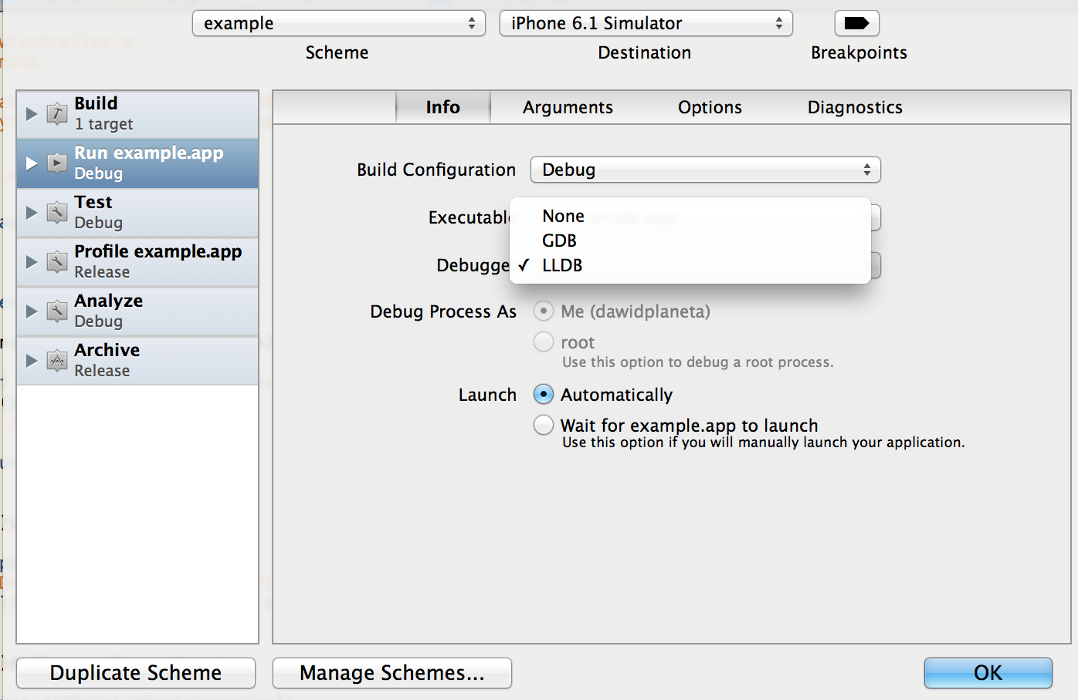
xCode 5.0 and GDB
Product -> Scheme -> Edit Scheme -> Run example.app (Xcode 4.6)
Xcode 5 does not support use of the LLVM-GCC compiler and the GDB debugger. Existing projects configured to use LLVM-GCC and GDB will be reconfigured to use the LLVM compiler and LLD

Slide 13
Why create LLDB?
Wanted better debugger
What was wrong with GDB?
Architecture
Parses information in large chunks
GDB was not designed to vend an API
Global variables contain program state
Different GDB binaries for each architecture
Pervasive preprocessor macros
Issues with expression parser
Objective-C properties

Slide 14
LLDB Improvements
￼Improved Objective-C debugging support
Objective-C property syntax
Full Objective-C class definitions
Data formatters now in LLDB
Objective-C and C++ STL types and collections
Watchpoints for desktop and iOS
Improved Python scripting

Slide 15
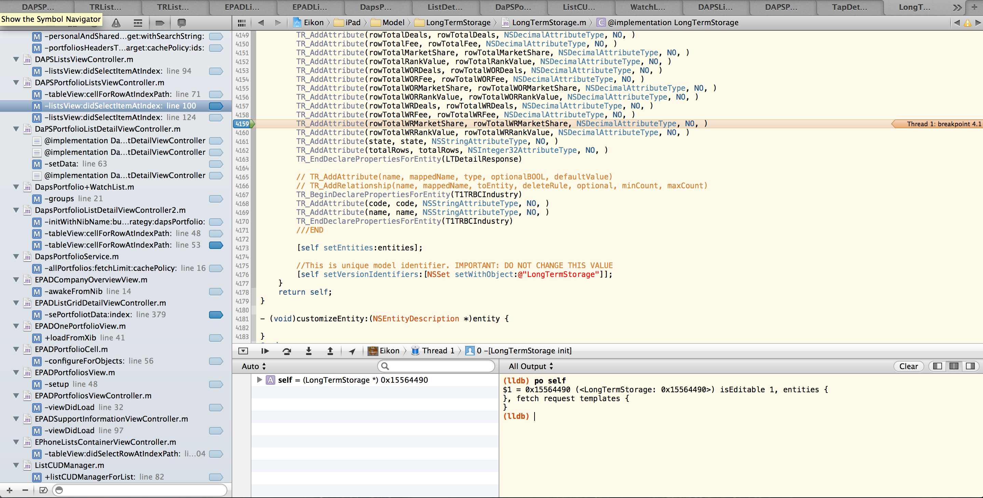
xCode 4 Debugging Environments
Discoverable form | expression --object-description -- foo
Abbreviated form | e -0 -- foo
Alias | po foo

Slide 16
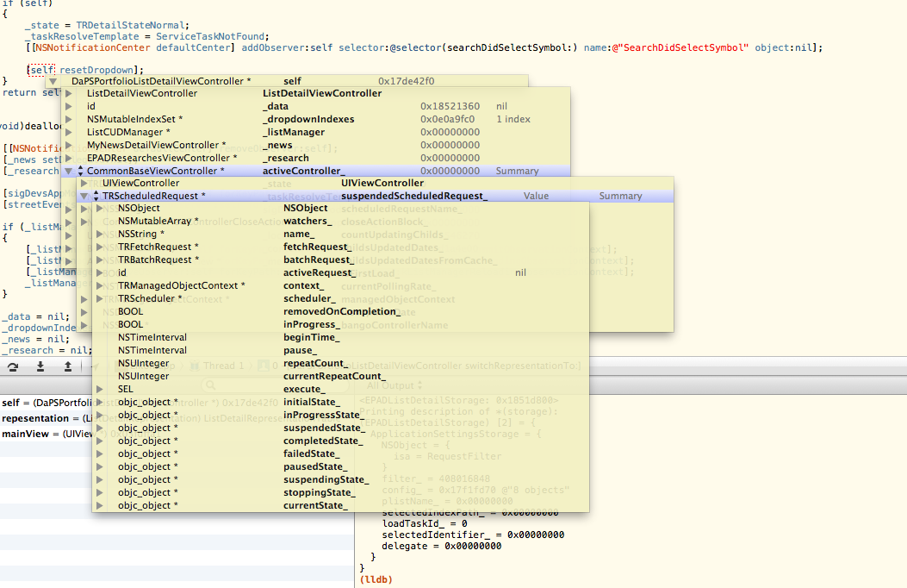
xCode 4 Debugging Environments

Slide 17
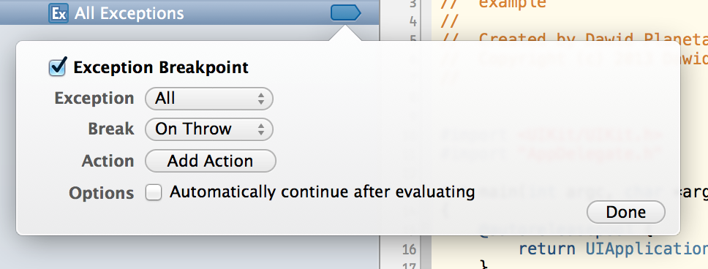
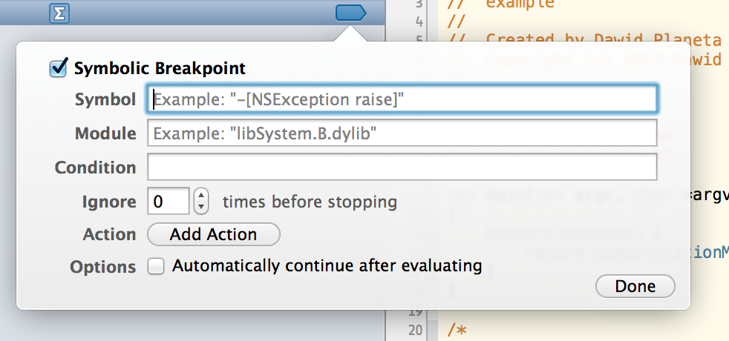
￼￼Exception and Symbolic Breakpoints

Slide 18
Creating Breakpoints – Question
How to track all low-level Objective-C functions?
(lldb) breakpoint set --name objc_msgSend
Breakpoint 1: where = libobjc.A.dylib`objc_msgSend, address = 0x010e008c
(lldb) thread backtrace
* thread #1: tid = 0x1c03, 0x010e008c libobjc.A.dylib`objc_msgSend, stop reason = breakpoint 1.1
frame #0: 0x010e008c libobjc.A.dylib`objc_msgSend
frame #1: 0x01c8ace1 CoreFoundation`__NSArrayEnumerate + 161
…
frame #16: 0x01beb668 GraphicsServices`GSEventRun + 104
frame #17: 0x00012ffc UIKit`UIApplicationMain + 1211
frame #18: 0x0000251d example`main(argc=1, argv=0xbffff36c) + 141 at main.m:16
frame #19: 0x00002445 example`start + 53
(lldb)

Slide 19
Creating Breakpoints – Question
How to track all low-level Objective-C functions?
(lldb) breakpoint set --name objc_msgSend
Breakpoint 1: where = libobjc.A.dylib`objc_msgSend, address = 0x010e008c
(lldb) breakpoint command add --script-type python 1
Enter your Python command(s). Type 'DONE' to end.
> frame1 = lldb.thread.GetFrameAtIndex(1)
> global str
> tmp = '%s : %s, frames: %i' % (frame1.module.file.basename, frame1.name, lldb.thread.num_frames)
> if str != tmp:
> str = tmp
> print tmp
> lldb.process.Continue()
> DONE

Slide 20
Creating Breakpoints – Command Line
Stop at a source line | breakpoint set --file file.m --line 4 b file.m:4
Stop whenever any object receives a selector | breakpoint set --selector drawRect: b drawRect:
Stop at a method | ￼breakpoint set --name "-[MyViewA drawRect:]" b "-[MyViewA drawRect:]"
Stop whenever any Objective-C object call any selector | breakpoint set --name objc_msgSend b obj_msgSend
 | Objective-C [obj selector:param] is C function in Objective-C runtime library objc_msgSend(obj, selector, parameters…)

Slide 21
Deleting Breakpoints
Listing breakpoint | breakpoint list br l
Deleting breakpoint | breakpoint delete 4 5 br del 4 5
(lldb) breakpoint list
Current breakpoints:
2: file ='ViewController.m', line = 31, locations = 1, resolved = 1
2.1: where = example`-[ViewController viewDidLoad] + 78 at ViewController.m:31, address = 0x00002b6e, resolved, hit count = 0
(lldb) breakpoint delete 2
1 breakpoints deleted; 0 breakpoint locations disabled.

Slide 22
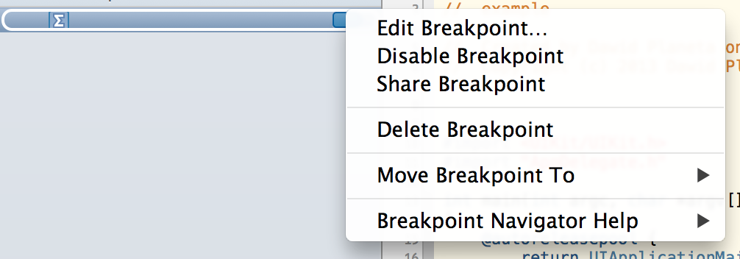
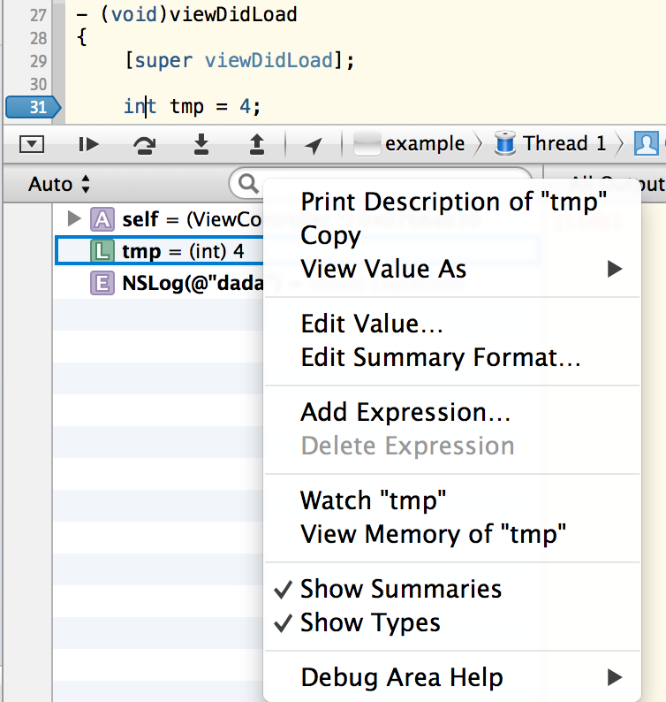
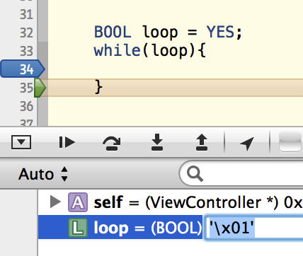
Editing Breakpoints and Variables
(lldb) frame variable
(ViewController *const) self = 0x0753be60
(SEL) _cmd = "viewDidLoad"
(BOOL) loop = YES
(lldb) expr loop=NO
(BOOL) $0 = NO

Slide 23
Expressions
The expression parser uses a full instance of the Clang compiler (front end compiler uses LLVM as its back end) in order to accurately evaluate expressions.
Expressions is compiled into an AST (Abstract Syntax Tree), then is generating a DWARF (standardized debugging data format) expression that contains simple opcodes that can be quickly re-evaluated each time an expression needs to be evaluated, or JIT'ed (machine code in a just-in-time compiler) up into code that can be run on the process being debugged.

Slide 24
Expressions
Syntax: expression <cmd-options> -- <expr>
Command Options Usage:
expression [-f <format>] [-G <gdb-format>] [-a <boolean>] [-d <boolean>] [-t <unsigned-integer>] [-u <boolean>] -- <expr>
expression [-o] [-a <boolean>] [-d <boolean>] [-t <unsigned-integer>] [-u <boolean>] -- <expr>
expression <expr>
User defined variables:
You can define your own variables for convenience or to be used in subsequent expressions.
You define them the same way you would define variables in C. If the first character of
your user defined variable is a $, then the variable's value will be available in future
expressions, otherwise it will just be available in the current expression.
Examples:
expr my_struct->a = my_array[3]
expr -f bin -- (index * 8) + 5
expr unsigned int $foo = 5
expr char c[] = "foo"; c[0]
IMPORTANT NOTE: Because this command takes 'raw' input, if you use any command options you must use ' -- ' between the end of the command options and the beginning of the raw input.

Slide 25
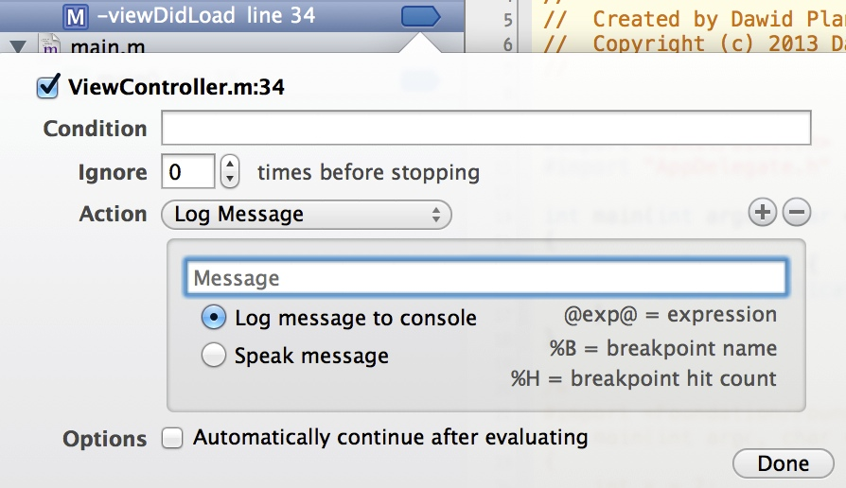
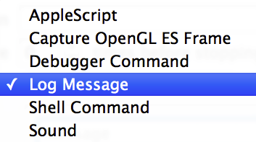
￼Breakpoint Actions

Slide 26
￼AppleScript
AppleScript is primarily a scripting language developed by Apple to do Inter-Application Communication (IAC) using AppleEvents.
The Open Scripting Architecture (OSA) provides a standard and extensible mechanism for interapplication communication in OS X. Communication takes place through the exchange of Apple events, a type of message designed to encapsulate commands and data of any complexity.
Apple events provide an event dispatching and data transport mechanism that can be used within a single application, between applications on the same computer, and between applications on different computers. The OSA defines data structures, a set of common terms, and a library of functions, so that applications can more easily create and send Apple events, as well as receive them and extract data from them.
Notes:
References:
http://developer.apple.com/library/mac/#documentation/AppleScript/Conceptual/AppleScriptX/AppleScriptX.html
https://developer.apple.com/library/mac/#documentation/applescript/conceptual/applescriptlangguide/introduction/ASLR_intro.html
https://en.wikipedia.org/wiki/AppleScript
http://mac.tutsplus.com/tutorials/automation/the-ultimate-beginners-guide-to-applescript-2/
do shell script "date >> $HOME/Desktop/LastUpdate.txt”
---
Send email: set recipientName to "Dawid Planeta"
set recipientAddress to "dplaneta@gmail.com"
set theSubject to "AppleScript Automated Email"
set theContent to "This email was created by Xcode breakpoint!"
--Mail Tell Block
tell application "Mail"
--Create the message
set theMessage to make new outgoing message with properties {subject:theSubject, content:theContent, visible:true}
--Set a recipient
tell theMessage
make new to recipient with properties {name:recipientName, address:recipientAddress}
--Send the Message
send
end tell
end tell

Slide 27
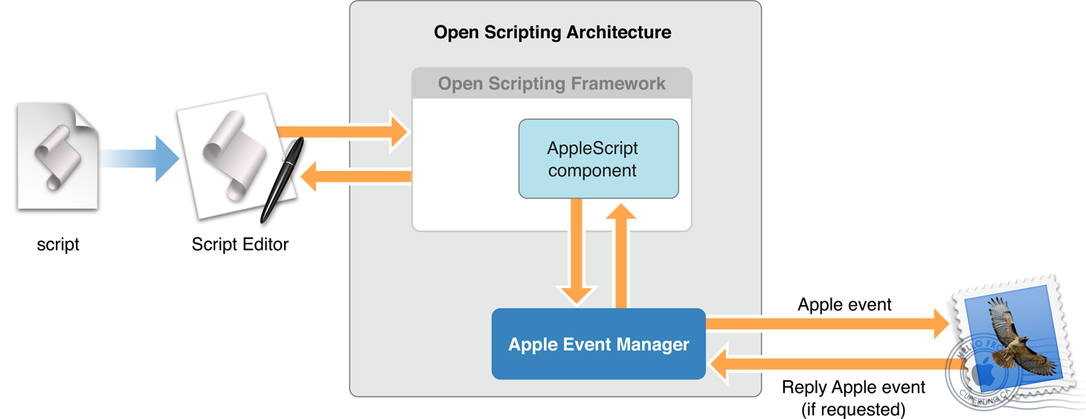
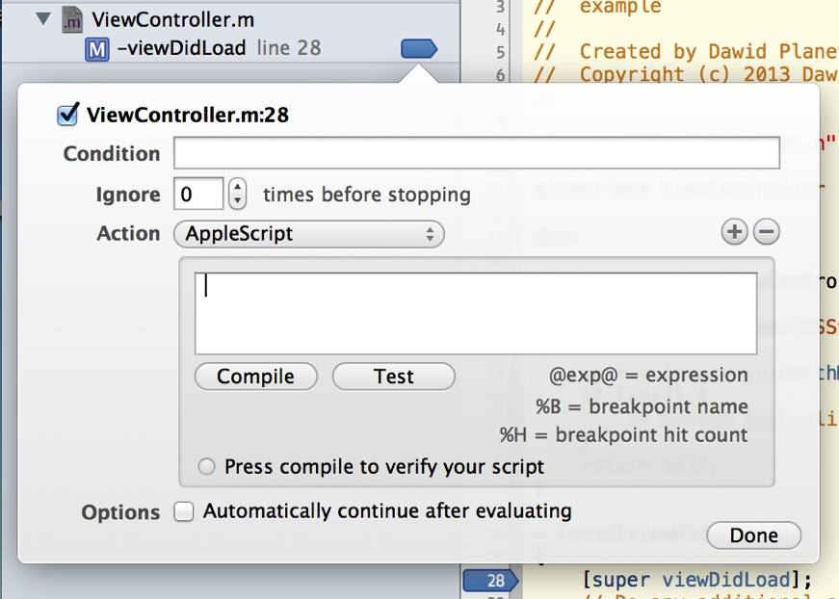
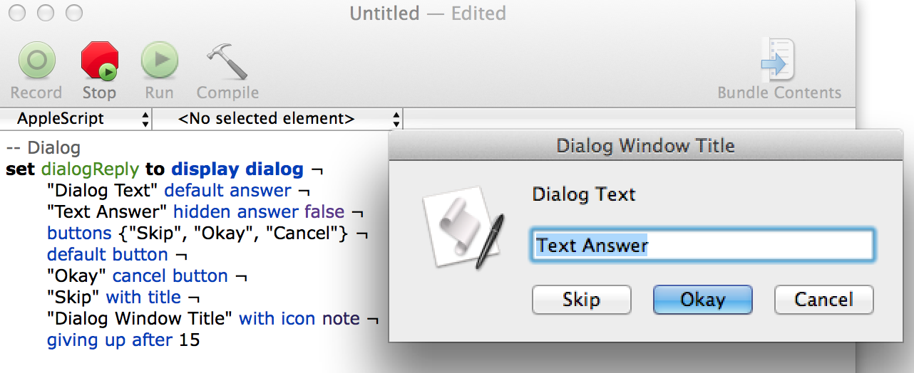
￼AppleScript
Notes:
References:
http://developer.apple.com/library/mac/#documentation/AppleScript/Conceptual/AppleScriptX/AppleScriptX.html
https://developer.apple.com/library/mac/#documentation/applescript/conceptual/applescriptlangguide/introduction/ASLR_intro.html
https://en.wikipedia.org/wiki/AppleScript
http://mac.tutsplus.com/tutorials/automation/the-ultimate-beginners-guide-to-applescript-2/
do shell script "date >> $HOME/Desktop/LastUpdate.txt”
---
Send email: set recipientName to "Dawid Planeta"
set recipientAddress to "dplaneta@gmail.com"
set theSubject to "AppleScript Automated Email"
set theContent to "This email was created by Xcode breakpoint!"
--Mail Tell Block
tell application "Mail"
--Create the message
set theMessage to make new outgoing message with properties {subject:theSubject, content:theContent, visible:true}
--Set a recipient
tell theMessage
make new to recipient with properties {name:recipientName, address:recipientAddress}
--Send the Message
send
end tell
end tell

Slide 28
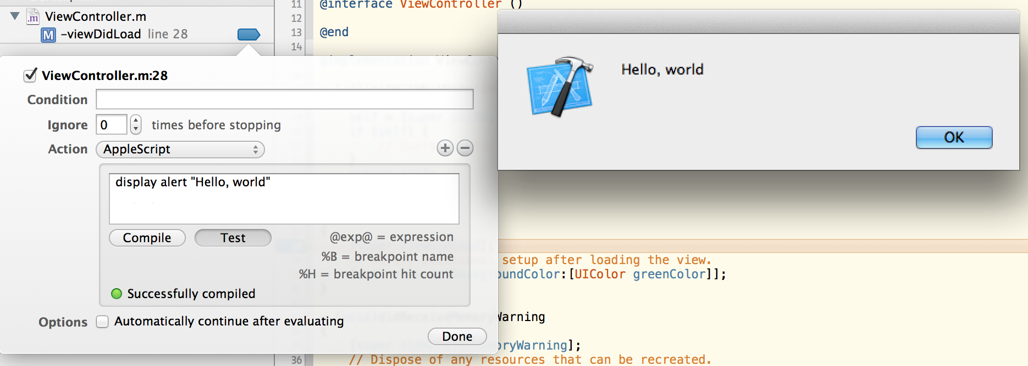
￼AppleScript Breakpoint Action
display dialog "Hello, world!"
display alert "Hello, world!”
do shell script "date >> $HOME/Desktop/breakUpdate.txt"
say "Hello, world!"
Notes:
Scripts:
do shell script "date >> $HOME/Desktop/breakUpdate.txt”
---

Slide 29
￼AppleScript Breakpoint Action
Call an other application.
tell application "Safari" to open location "http://www.google.com"
tell application "Safari"
activate
do JavaScript "window.open('http://www.google.com')" in document 1
end tell
Check internal and external IP
set internalIP to IPv4 address of (get system info)
set externalIP to word 25 of (do shell script "curl checkip.dyndns.org")
display alert "internal IP: " & internalIP & ”\nexternal IP: " & externalIP
Notes:
Scripts:
tell application "Safari" to open location "http://www.google.com”
---
tell application "Safari"
activate
do JavaScript "window.open('http://www.google.com')" in document 1
end tell
---
set internalIP to IPv4 address of (get system info)
set externalIP to word 25 of (do shell script "curl checkip.dyndns.org")
display alert "internal IP: " & internalIP & ”\nexternal IP: " & externalIP

Slide 30
￼AppleScript Breakpoint Action
set recipientName to "Dawid Planeta"
set recipientAddress to ”dawid@email.com"
set theSubject to "AppleScript Automated Email"
set theContent to "This email was created by Xcode breakpoint!"
--Mail Tell Block
tell application "Mail"
--Create the message
set theMessage to make new outgoing message with properties {subject:theSubject, content:theContent, visible:true}
--Set a recipient
tell theMessage
make new to recipient with properties {name:recipientName, address:recipientAddress}
--Send the Message
send
end tell
end tell
Notes:
set recipientName to "Dawid Planeta"
set recipientAddress to "dawid@maill.com"
set theSubject to "AppleScript Automated Email"
set theContent to "This email was created by Xcode breakpoint!"
--Mail Tell Block
tell application "Mail"
--Create the message
set theMessage to make new outgoing message with properties {subject:theSubject, content:theContent, visible:true}
--Set a recipient
tell theMessage
make new to recipient with properties {name:recipientName, address:recipientAddress}
--Send the Message
send
end tell
end tell

Slide 31
￼AppleScript Breakpoint Action
Opportunities?
Benefits?

Slide 32
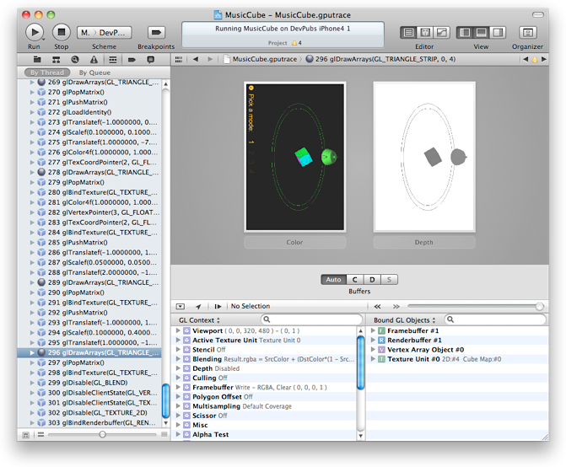
Capture OpenGL ES Frame
OpenGL ES Debugging is presented comprehensively in the second part of the presentation.

Slide 33
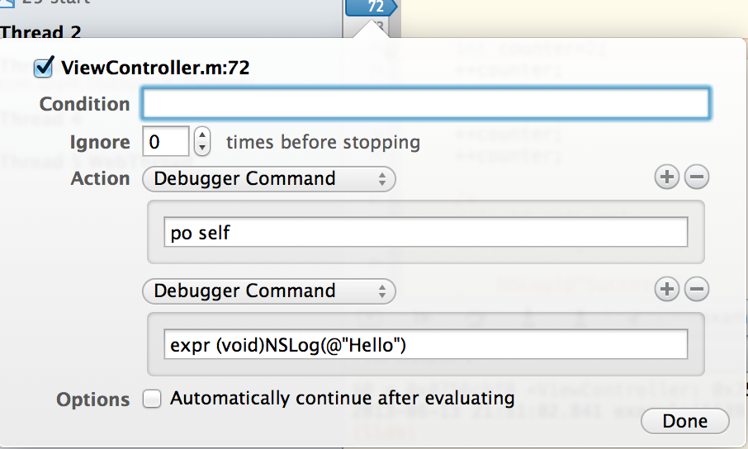
Debugger Command

Slide 34
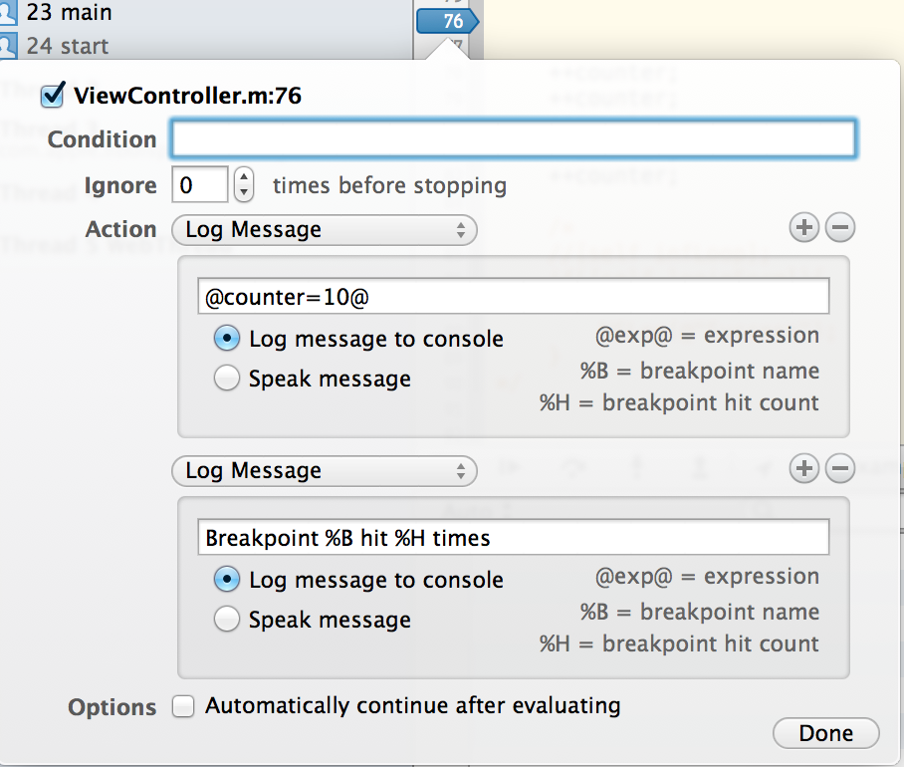
Log Message

Slide 35
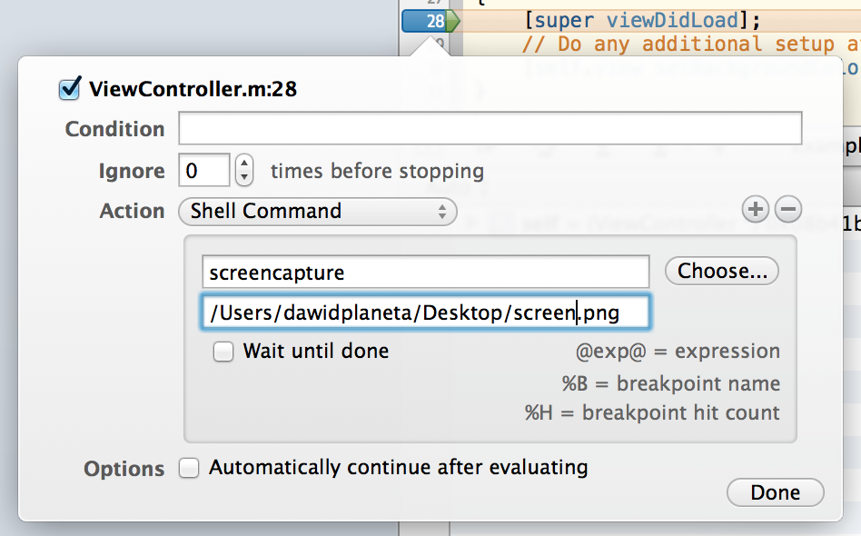
￼Shell Command Breakpoint Action
Run command-line programs using shell commands. For example you can take screenshot and check memory leaks using external tools.
Command: screencapture
/Users/dawidplaneta/Desktop/screenshot.png
Or call our script
Command: sh
/Users/dawidplaneta/Desktop/leakScript.sh
#!/bin/bash
leaks -nocontext -nostacks iPhone\ Simulator > $HOME/Desktop/simLeaks.txt
exit
Notes:
leaks -nocontext -nostacks iPhone\ Simulator > $HOME/Desktop/simLeaks.txt
/Users/dawidplaneta/Desktop/screenshot.png
References:
https://developer.apple.com/library/mac/documentation/darwin/reference/manpages/man1/leaks.1.html
http://jprithvi.wordpress.com/tag/debugger-breakpoint-actions/

Slide 36
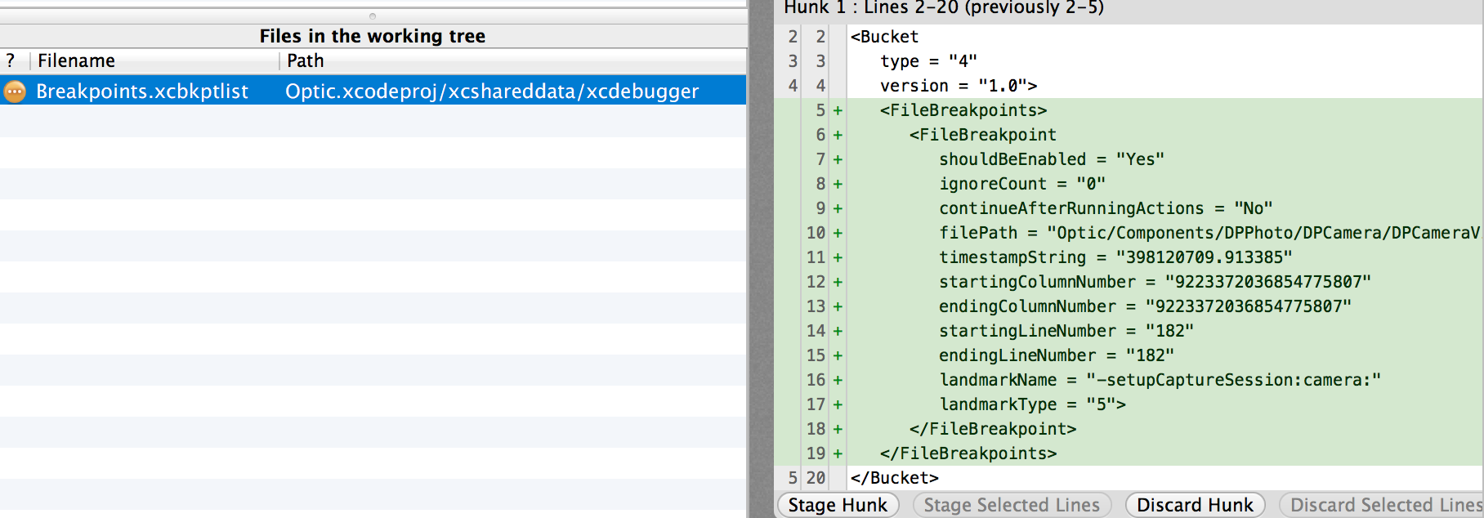
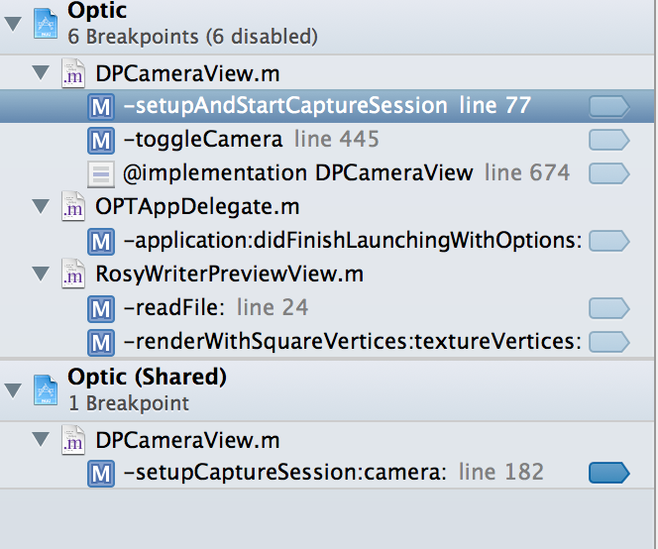
Sharing Breakpoints

Slide 37
Breakpoint commands
Set a breakpoint at all functions named main.
(gdb) break main | (lldb) breakpoint set --name main (lldb) br s -n main (lldb) b main
Set a breakpoint in file test.c at line 12.
(gdb) break test.c:12 | (lldb) breakpoint set --file test.c --line 12 (lldb) br s -f test.c -l 12 (lldb) b test.c:12
Set a breakpoint at all C++ methods whose basename is main.
(gdb) break main | (lldb) breakpoint set --method main (lldb) br s -M main
Set a breakpoint at and object C function: -[NSString stringWithFormat:].
(gdb) break -[NSString stringWithFormat:] | (lldb) breakpoint set --name "-[NSString stringWithFormat:]" (lldb) b -[NSString stringWithFormat:]
Set a breakpoint at all Objective C methods whose selector is count.
(gdb) break count | (lldb) breakpoint set --selector count (lldb) br s -S count

Slide 38
Breakpoint commands
Set a conditional breakpoint
(lldb) breakpoint set --selector example2: -c 'i==2’
(lldb) breakpoint set -S example3: -c '(BOOL)[$eax isEqualToString:@"Password2"]'
Breakpoint 3: where = example`-[ViewController example3:] + 32 at ViewController.m:60, address = 0x00002e10
(lldb) breakpoint command add Enter your debugger command(s). Type 'DONE' to end.
> expr str=@"newPassword"
> c
> DONE
- (void)example2:(NSInteger)i{ NSLog(@"example2: %i", i); }
- (NSString*)example3:(NSString*)str{ return str; }
…
NSLog(@"password: %@",[self example3:@"Password1"]);
NSLog(@"password: %@",[self example3:@"Password2"]);

Slide 39
Breakpoint commands
Setting a regular expression breakpoint
Set a breakpoint by regular expression on source file contents.
(gdb) rbreak regular-expression | (lldb) breakpoint set --func-regex regular-expression (lldb) br s -r regular-expression
Match every method from class
(lldb) breakpoint set --func-regex CLASS_NAME (lldb) breakpoint set --func-regex "\[CLASS_NAME" (lldb) breakpoint set --func-regex "\[CLASS_NAME METHOD_NAME:\]"
Match every function in the shared library.
The regular expression '.' will match any string that has at least one character in it, so we will use that.
(lldb) breakpoint set --func-regex=. --shlib=libsqlite3.dylib
Notes:
References
http://lldb.llvm.org/python-reference.html

Slide 40
Breakpoint commands examples
Setting a regular expression breakpoint
Example
(lldb) breakpoint set --func-regex "\[DaPSPortfolioListDetailViewController" (lldb) breakpoint command add 13 Enter your debugger command(s). Type 'DONE' to end.
> script print "========="
> thread backtrace
> continue
> DONE

Slide 41
Breakpoint commands examples
Setting a regular expression breakpoint
Example
(lldb) script global counter
(lldb) script counter = 0
(lldb) breakpoint set --func-regex "\[DaPSPortfolioListDetailViewController"
Breakpoint 22: 5 locations.
(lldb) breakpoint command add --script-type python 22
Enter your Python command(s). Type 'DONE' to end.
> global counter
> counter += 1
> print '[%i] %s' % (counter, frame.GetFunctionName())
> return TRUE
> DONE

Slide 42
Breakpoint commands
Set a breakpoint by regular expression on source file contents.
(gdb) shell grep -e -n pattern source-file (gdb) break source-file:CopyLineNumbers | (lldb) breakpoint set --source-pattern regular-expression --file SourceFile (lldb) br s -p regular-expression -f file
List some or all breakpoints at configurable levels of detail.
(gdb) info break | (lldb) breakpoint list (lldb) br l
Delete a breakpoint.
(gdb) delete 1 | (lldb) breakpoint delete 1 (lldb) br del 1
Clears a breakpoint or set of breakpoints in the executable.
 | (lldb) breakpoint clear
A set of commands for adding, removing and examining bits of code to be executed when the breakpoint is hit (breakpoint 'commmands').
 | (lldb) breakpoint command

Slide 43
Breakpoint commands
Do a source level single step in the currently selected thread.
(gdb) step (gdb) s | (lldb) thread step-in (lldb) step (lldb) s
Do a source level single step over in the currently selected thread.
(gdb) next (gdb) n | (lldb) thread step-over (lldb) next (lldb) n
Do an instruction level single step in the currently selected thread.
(gdb) stepi (gdb) si | (lldb) thread step-inst (lldb) si
Do an instruction level single step over in the currently selected thread.
(gdb) nexti (gdb) ni | (lldb) thread step-inst-over (lldb) ni
Return immediately from the currently selected frame, with an optional return value.
(gdb) return <RETURN EXPRESSION> | (lldb) thread return <RETURN EXPRESSION>

Slide 44
Examining Variables
Show the arguments and local variables for the current frame.
(gdb) info args (gdb) info locals | (lldb) frame variable (lldb) fr v
Show the local variables for the current frame.
(gdb) info locals | (lldb) frame variable --no-args (lldb) fr v -a
Show the contents of local variable "bar".
(gdb) p bar | (lldb) frame variable bar (lldb) fr v bar (lldb) p bar
Show the contents of local variable "bar" formatted as hex.
(gdb) p/x bar | (lldb) frame variable --format x bar (lldb) fr v -f x bar
Show the global/static variables defined in the current source file.
 | (lldb) target variable (lldb) ta v

Slide 45
Examining Variables
Example
Display the arguments and local variables only when you stop in an object of the class named ViewController.
(lldb) target stop-hook add --classname ViewController --one-liner "frame variable"
Stop hook #1 added.
…
(ViewController *const) self = 0x07566a60
(SEL) _cmd = "viewDidLoad"
(int) x = 0

Slide 46
Watchpoint commands
Set a watchpoint on a variable when it is written to.
(gdb) watch global_var | (lldb) watchpoint set variable global_var (lldb) wa s v global_var
Set a watchpoint on a memory location when it is written into. The size of the region to watch for defaults to the pointer size if no '-x byte_size' is specified. This command takes raw input, evaluated as an expression returning an unsigned integer pointing to the start of the region, after the '--' option terminator.
(gdb) watch -location g_char_ptr | (lldb) watchpoint set expression -- my_ptr (lldb) wa s e -- my_ptr
Set a condition on a watchpoint.
 | (lldb) watch set var global (lldb) watchpoint modify -c '(global==5)' (lldb) c
List all watchpoints.
(gdb) info break | (lldb) watchpoint list (lldb) watch l
Delete a watchpoint.
(gdb) delete 1 | (lldb) watchpoint delete 1 (lldb) watch del 1

Slide 47
Watchpoint commands
A set of commands for adding, removing and examining bits of code to be executed when the watchpoint is hit (watchpoint 'commmands').
 | (lldb) watchpoint command
Disable/Enable the specified watchpoint(s) without removing it/them. If no watchpoints are specified, disable/enable them all.
 | (lldb) watchpoint disable/enable
Set ignore count on the specified watchpoint(s). If no watchpoints are specified, set them all.
 | (lldb) watchpoint ignore
Modify the options on a watchpoint or set of watchpoints in the executable. If no watchpoint is specified, act on the last created watchpoint. Passing an empty argument clears the modification.
 | (lldb) watchpoint modify

Slide 48
Watchpoint commands example
(lldb) watchpoint set variable counter
Watchpoint created: Watchpoint 1: addr = 0xbfffdb4c size = 4 state = enabled type = w
declare @ '/Users/dawidplaneta/Documents/Objective-C kruczki/example/example/ViewController.m:74'
watchpoint spec = 'counter'
new value: 0
(lldb) watchpoint modify --condition 'counter==5’
(lldb) watchpoint command add 1 -o bt
* thread #1: tid = 0x1c03, 0x00002f45 example`-[ViewController viewDidLoad](self=0x0717b400, _cmd=0x005c5a77) + 101 at ViewController.m:78, stop reason = watchpoint 1
frame #0: 0x00002f45 example`-[ViewController viewDidLoad](self=0x0717b400, _cmd=0x005c5a77) + 101 at ViewController.m:78
...
Watchpoint 1 hit:
old value: 0
new value: 5
int counter=2;
++counter;
++counter;
++counter;
++counter;
++counter;

Slide 49
Examining Thread State
Show the stack backtrace for the current thread.
(gdb) bt | (lldb) thread backtrace (lldb) bt
Show the stack backtraces for all threads.
(gdb) thread apply all bt | (lldb) thread backtrace all (lldb) bt all
Select a different stack frame by index for the current thread.
(gdb) frame 12 | (lldb) frame select 12 (lldb) fr s 12 (lldb) f 12
List information about the currently selected frame in the current thread.
 | (lldb) frame info
Select a different stack frame using a relative offset.
(gdb) up 2 (gdb) down 3 | (lldb) frame select --relative 2 (lldb) fr s -r2 (lldb) frame select --relative -3 (lldb) fr s -r-3

Slide 50
Examining Thread State
Show the general purpose registers for the current thread.
(gdb) info registers | (lldb) register read
Write a new decimal value '123' to the current thread register 'rax'.
(gdb) p $rax = 123 | (lldb) register write rax 123
Skip 8 bytes ahead of the current program counter (instruction pointer). Note that we use backticks to evaluate an expression and insert the scalar result in LLDB.
(gdb) jump *$pc+8 | (lldb) register write pc `$pc+8`
Read memory from address 0xbffff3c0 and show 4 hex uint32_t values.
(gdb) x/4xw 0xbffff3c0 | (lldb) memory read --size 4 --format x --count 4 0xbffff3c0 (lldb) me r -s4 -fx -c4 0xbffff3c0 (lldb) x -s4 -fx -c4 0xbffff3c0
Disassemble the current function for the current frame.
(gdb) disassemble | (lldb) disassemble --frame (lldb) di –f // Show mixed source and disassembly (lldb) disassemble --frame --mixed (lldb) di -f -m

Slide 51
More LLDB commands
http://lldb.llvm.org/

Slide 52
iOS Debugging – Part II
PART I
The xCode debugging environments
Exception and Symbolic Breakpoints
Editing and Managing Breakpoints
Breakpoint Actions
Breakpoint commands
PART II
Python Scripting
Custom LLDB Command
XPC debugging
OpenGL ES Debugging
UIWebViews Debugging
Core Data Debugging
PART III
Targeting debugging
Continuous Integration Debugging
Hacking and Securing iOS Applications
Thank you and welcome to the second part

