Slide 1



Penetration Testing
For iOS Applications

Slide 2
NSLog (@”Hello, OWASP!”);
About me!
Jason Haddix – Director of Penetration Testing HP Fortify
Former Netpen guy
Current Mobile and Webpen guy
ShadowLabs Guy

Slide 3

Fortify on Demand does dynamic testing for web apps, mobile, special projects, bakeoffs, etc…
That’s us

Slide 4
Rough Agenda (we will digress)
Quick Overview of the iPhone Platform
Threat Modeling 3rd party applications
Environment Setup
Whitebox Assessments
Blackbox Assessments

Slide 5



Tech Stack
800 MHz dual-core ARM Processor
Objective-C
Core Services + Cocoa (Media & UI APIs)
iOS (fork of Darwin (fork of BSD))
Language
Jailbreak
Operating System
ARM Executables

Slide 6


What does an iOS Application Look Like?
iOS Applications:
  In Development with Apple SDK Xcode:
    Distributed as XCode Project Folders
  Compiled and deployed through the app store:
    Compiled as ARM
    Distributed as “.ipa” files
    zip files containing app resources and ARM executable
Deployed as “.app” directories
Executable code is:
  encrypted with FairPlay DRM (AES)
  signed with Apple’s signature

Slide 7
What does an iOS Application Look Like?
Objective - C (in Xcode)
Compiled to ARM and encrypted
Packaged as IPA file with resources
Deployed to phone file system as .app directory

Slide 8
Types of iOS Applications
Web Applications:
  HTML + CSS + JavaScript
  Run inside Safari/Webkit
Native Applications:
  Written in Objective-C (+ C/C++)
  Compiled into ARM for actual devices, x86 for iOS Simulator

Slide 9

Objective-C
Objective-C is a superset of C, this means all C code still applies.
[self doSomethingWithVar:var1];

Slide 10
How do we Test?
Two different approaches to testing:
  Whitebox testing
    Full information and source code provided
  Blackbox testing
    No code or information provided
    Working only with downloadable app
Three areas to focus on:
  Attack the network communication
  Attack the server component
  Attack the client component

Slide 11
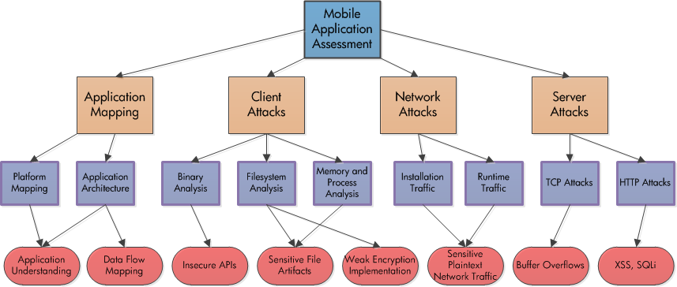
Methodology Breakdown

Slide 12
Threat Modeling 3rd Party Apps
Identify business objectives
Identify user roles that will interact with the application
  Track higher and lower roles functions
Identify the data the application will manipulate
  PII vs Non-PII
  Credentials & access
  Where is it stored?
What happens if the user loses his Phone? Or it’s stolen?
  Individual applications data lost, how bad is it?
What happens if there’s an OS/Kernel exploit? (silent jailbreak)
  Mass user data loss, always bad

Slide 13
Reminders
Many apps will encode sensitive data, not encrypt. Look for:
  Base64
    cGFzc3dvcmQ=
  Hex
    70617373776f7264
  Decimal
    112 97 115 115 119 111 114 100
  Md5
    5f4dcc3b5aa765d61d8327deb882cf99
  SHA1
    5baa61e4c9b93f3f0682250b6cf8331b7ee68fd8

Slide 14
Reminders
PII for a mobile app can be different that what you expect. Look for:
  Usernames
  Passwords
  UDID
  Geolocation/address/zip
  DOB
  Device Name
  Network Connection Name
  Application Data
    Updates to Social media
    Chat logs
    cookies

Slide 15
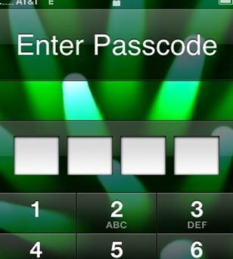
Hardware Encryption and MDM Will Save Us!
Hardware encryption in iOS only applies where specifically called and to mail and SMS
Key to unencrypt the data is stored in effaceable storage.
Hardware encryption without MDM is susceptible to brute force attacks
  24 min to break a 4 digit PIN
Hardware encryption with MDM, with remote wipe enabled, and long PIN
  Best option
http://goo.gl/HcHXN

Slide 16
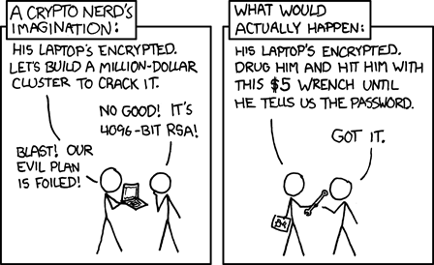
The big takeaway with iOS Encryption?
Physical access wins!
Plus you can always pulls some super cool spy moves!
http://goo.gl/UWtg

Slide 17
Whitebox Testing

Slide 18

WhiteBox Environment Setup
Tool List:
Your Mac:
  Xcode (newest)
    Build/analyze/clang
    Property List Editor
    Plutil
    otool
  Instruments
  Wireshark/Tshark/…
  netcat
  Nmap
  Burp Suite
  Flawfinder
  SQLite Manger
  FuzzDB
  Command Line Knowledge
http://goo.gl/kX6PA

Slide 19
Anatomy of an Application in iOS Sim
Show all files: defaults write com.apple.Finder AppleShowAllFiles YES
Users/$username/Library/Application Support/iPhone Simulator/Applications/$appID
  ./Documents = properties, logs
  ./Library/Caches = cachey things
  ./Library/Caches/Snapshots = screenshots of your app
  ./Library/Cookies = cookie plists
  ./Library/Preferences = various preference plists
  ./Library/WebKit = WebKit local storage
  ./Appname.app = app resources: binary, graphics, nibs, Info.plist
  ./tmp = tmp and logs sometimes
*David Thiel, Secure iOS Development, iSec Partners

Slide 20




Whitebox – Client-Side Testing
Analyze/SCA Tools
Identify HTTP(S) and web service URLs
Parse Web Service Functions
Identify Filesystem Interaction & Data Storage
Manual Source code Inspection

Slide 21

Analyzing & SCA Tools
Build and Analyze
  Funnily enough Xcode has a built in source code scanner formerly known as CLANG.
  http://clang-analyzer.llvm.org/available_checks.html
  Use it to find:
    memory leaks
    accessing uninitialized variables
    dereferencing null pointers

Slide 22
Analyzing
Preferences -> show line numbers

Slide 23
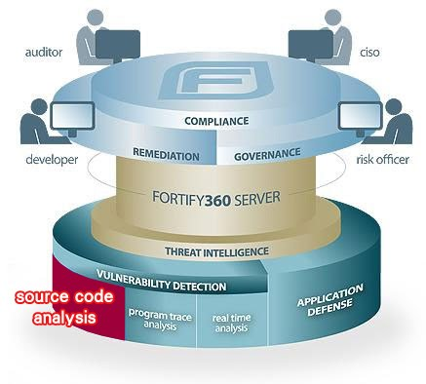
SCA
Fortify already supports C libraries.
Fortify Objective-C
Flawfinder
  http://www.dwheeler.com/flawfinder/
  http://msdn.microsoft.com/en-us/library/bb288454.aspx

Slide 24
Identifying HTTP(S) and WS Calls
Parse source code path for all URLs and Web Services the app is calling:
Command (dirty):
  grep -r -a "://" $project_path | awk -F "http" '{print $2}' |sort –u
    :// represents standard http
    s:// is https call
  Or in X-Code search for ://
  Since we’re in source this will give us URLs in comments as well

Slide 25
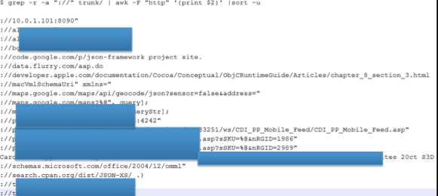
Identifying HTTP(S) and WS Calls
Output:

Slide 26
Parsing WS/API Functions
Follow up on interesting links by tracking down the file it appeared in:
  grep -r -F “://interestingURL”
Hopefully doing this you will find NSUrl / constant definitions or variable names.

Slide 27
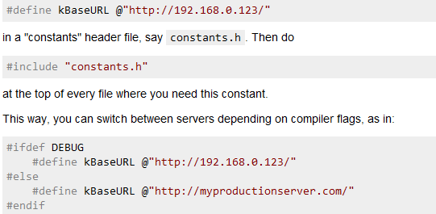
Parsing WS/API Functions

Slide 28
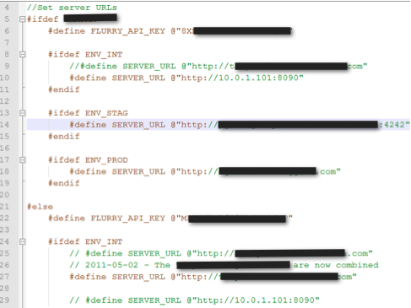
Parsing WS/API Functions

Slide 29
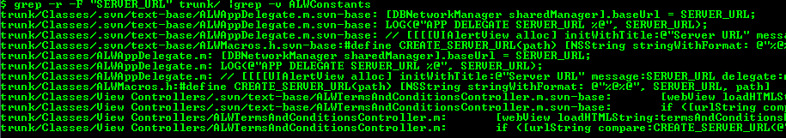
Parsing WS/API Functions
Now we can track down associated GETS and POSTS with Parameters, searching for the constant/variable names:
Now we have a better mapping of the WS and its calls
Avoid the .svn directories
  | Grep –v .svn

Slide 30
Identifying File System and Data Storage
iOS apps use a variety of methods for storage… almost all of them suck. Basically any credential or PII stored on the client side is 80% of the time a vulnerability.

Slide 31
Identifying File System and Data Storage
Bundled with X-code in Lion is Instruments which we can use to monitor the iOS simulator and what our target application does. You can compare it to several SysInternals tools. The type of data it can capture includes:
  File Activity monitoring
  Memory Monitoring
  Process Monitoring – similar to procmon
  Network Monitoring – similar to netmon
  The tool can be launched from the Xcode Menu -> Open Developer Tool-> Instruments

Slide 32
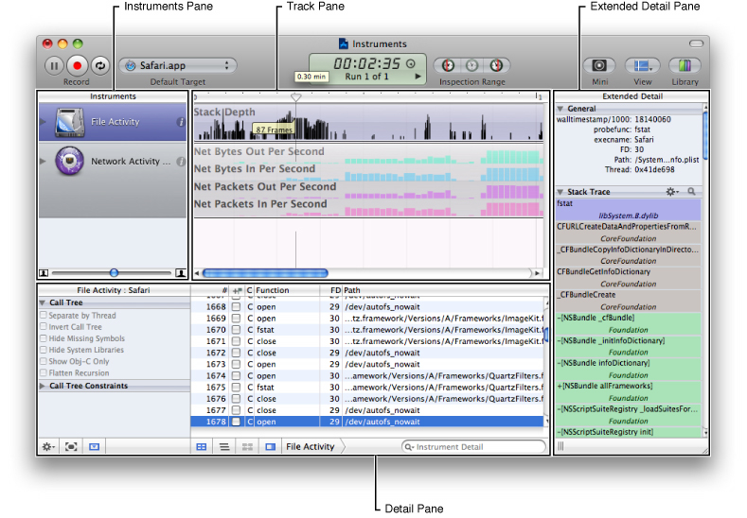
Identifying File System and Data Storage
instruments-the-mac, http://goo.gl/mKoiQ

Slide 33
Identifying File System and Data Storage
Areas of interest:
  Plists
  SQLite3 Databases
  Keychain
  Temp Files

Slide 34
Plists
Used by iPhone to store saved properties and data
  XML
  Binary (compressed XML) (depreciated)
The binary plists need converting, you can use:
  plutil to convert to XML
  Property List Editor (in XCode)
plists contain all kinds of juicy information. Check for:
  Cookies, emails, usernames, passwords, sensitive application data, client side role identifiers, protocol handlers, etc.

Slide 35
Plists
Run app in simulator, provide credentials to everything you can, use the app thoroughly.
  App creds
  Twitter
  Facebook

Slide 36
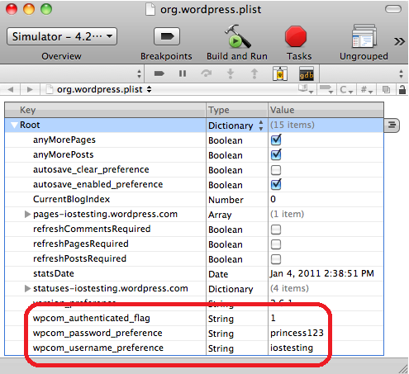
Plists
Frank Kim, SANS Appsec Blog, http://goo.gl/f0HsM

Slide 37
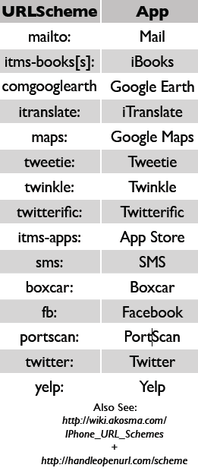
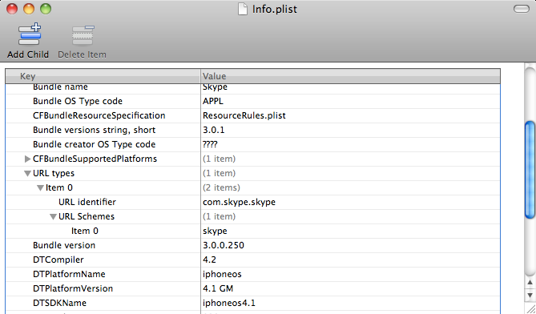
Plists
A bit about URLSchemes:
  Locate Info.plist file. Open with “Property List Editor” or
  convert to XML: plutil -convert xml1 Info.plist
  The info.plist will define any custom protocol handlers

Slide 38
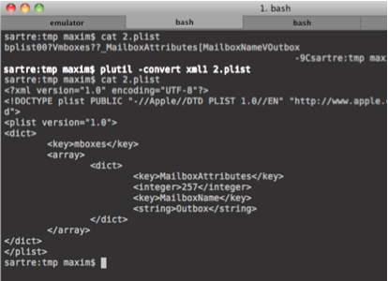
Plists
Plutil:
Foundstone Pentesting iPhone , http://goo.gl/g79pY

Slide 39

SQLite
A lot of iOS applications sensitive data in SQLite3 databases on the device.
Sqlite3 does not have built-in support for encryption.

Slide 40
SQLite
There are extensions (CEROD is one, sqlcipher is another) that support encryption, but the code is not publicly available, you need to license it. Apple has not, so the included version of sqlite3 does not support encrypted databases.
Still dangerous to store stuff client side. Even with extensions you can reverse out encryption keys () from the memory of a jailbroken phone and decrypt the database.or breakpoint after decryption) to bypass:
  Cerod is as simple as looking for “cerod:passwd” or break pointing and pulling out of memory:
  sqlite3_open(":cerod:passwd:filename.db", &db);
  http://www.hwaci.com/sw/sqlite/cerod.html

Slide 41
KeyChain
Keychain = Encrypted container for storing sensitive information
Smarter devs store passwords and sensitive data using the keychain. Unfortunately with access to a phone and jailbreaking we can unencrypt the keychain and dump the contents.
See what you app is using the KC for:
        grep -r -F “kSecAttr" $project_path/ | grep -v .svn
Or “SFHFKeychainUtils”
Threat Model this data… We will go over blackbox methods for dumping the KC later.

Slide 42
Side Channel Data Leakage
iOS apps have a number of “features” that can be security vulnerabilities.
  Logging Files
  Caching
    File Caching
    Keyboard Caching
    Snapshot Caching
    Clipboard Caching

Slide 43

Logging
iOS Logs lots of data, NSLog especially, They can be viewed after the fact in:
  ~/Library/Logs/CrashReporter/MobileDevice/<Device name>/private/var/log/system.log
  Custom Logging:
    NSLog:
      grep -r -F “NSLog" $project_path/ | grep -v .svn
      Can be viewed in you mac “console” app under utilities

Slide 44
File Caching
If the application uses PDF, Excel, or other files it may be possible that these files may have been cached on the device. These can be found at:
  ~/Library/Application Support/iPhone simulator/x.x.x/Applications/<application folder>/Documents/temp.pdf

Slide 45
Keyboard Caching
Keystrokes for predictive spellcheck are stored in:
  ~/Library/Application Support/iPhone Simulator/x.x.x/Library/Keyboard/dynamic-text.dat
This issue is similar to autocomplete for web browsers.
Already disabled for password fields
Should be disabled for any potentially sensitive fields (account numbers, SSN, etc, etc…)
Set UITextField property autocorrectionType = UITextAutocorrectionNo for mitigation.

Slide 46
Snapshot Caching
When in an application and the home button is pushed, the application stores a snapshot (screenshot) in the apps snapshot folder:
~/Library/Application Support/iPhone Simulator/x.x.x/Applications/<application folder>/Library/Caches/Snapshots/
These persist until reboot.
Hopefully you weren’t on a screen with any sensitive data!

Slide 47
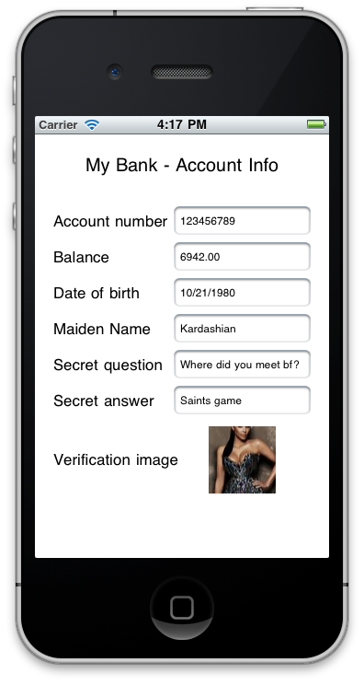
Snapshot Caching
Frank Sims, SANS, http://goo.gl/aFQrx

Slide 48
Manual Source Review
Just some pointers, not full blown manual sca:
Insufficient transport – identify bad SSL
Injection
  SQL
  XSS
  Format String
  LFI

Slide 49
SQL Injection Client-Side
SQL injection is a problem on the client side too!
BAD:
  NSString *sql = [NSString stringWithFormat:@"SELECT name FROM products
  WHERE id = '%@'", id];
  const char *query = [sql UTF8String];
GOOD:
  const char *sql = "SELECT name FROM products WHERE id = ?";
  sqlite3_prepare_v2(database, sql, -1, &sql_statement, NULL);
  sqlite3_bind_text(&sql_statement, 1, id, -1, SQLITE_TRANSIENT);
Ilja van Sprundel; IOActiveAuditting iPhone and iPad applications

Slide 50
XSS Client-Side
UIwebView
Renders web content inside an application with webkit:
  Javascript
  HTML
  PDF
  Office Documents (XLS, PPT, DOC)
  iWork Documents (Pages, Numbers, Keynote)
•If the webView is based off of user input XSS can be triggered

Slide 51
XSS Client-Side
Can occur whenever user controlled Objective C variables populated in to WebView
  stringByEvaluatingJavaScriptFromString
  NSString *javascript = [[NSString alloc] initWithFormat:@"var myvar=\"%@\";", username];
  [mywebView stringByEvaluatingJavaScriptFromString:javascript];
Ilja van Sprundel; IOActiveAuditting iPhone and iPad applications

Slide 52
Other Injection Attacks
LFI’s : User controlled input to NSFileManager can lead to LFI’s (../../../../)
Format String attacks…

Slide 53
Format String Attacks
vulnerable obj-c methods:
• NSLog()
• [NSString stringWithFormat:]
• [NSString initWithFormat:]
• [NSMutableString appendFormat:]
• [NSAlert informativeTextWithFormat:]
• [NSPredicate predicateWithFormat:]
• [NSException format:]
• NSRunAlertPanel

Slide 54
Whitebox – Network & Server Testing
Insufficient Transport
  Proxy Simulator
  SSL Checking
  Pulling items out of streams
  Web Service Testing

Slide 55
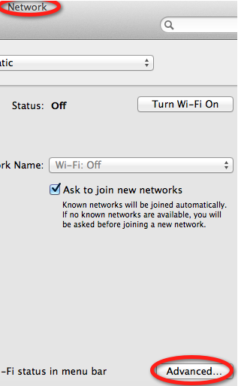
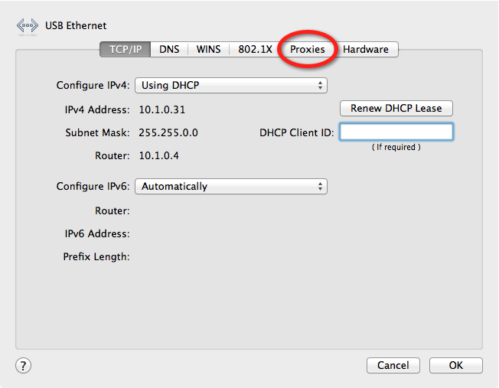
Proxying The Simulator
Network -> Advanced -> Proxies ->

Slide 56
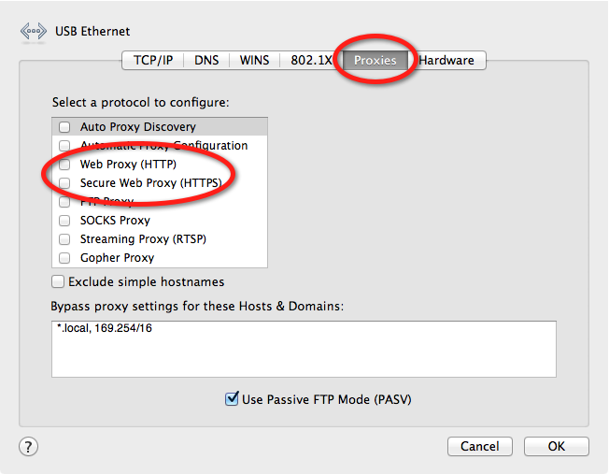
Proxying The Simulator
Network -> Advanced -> Proxies -> Web Proxy & Secure Web Proxy

Slide 57
Proxying The Simulator
SSL Sucks =(
Get Burp cert
iOS simulator needs the cert stored in the ~/Library/Application Support/iPhone Simulator/<SDK version>/Library/Keychains/ directory on your Mac
Use python script by Gotham Digital Science to add the cert to the db:
https://github.com/GDSSecurity/Add-Trusted-Certificate-to-iOS-Simulator
python add_ca_to_iossim.py PortSwiggerCA.cer

Slide 58
Blackbox Testing

Slide 59
Blackbox– Client-Side Testing
Jealbreak and install Cydia Package manager
Identify application directories
Obtain app
Parse out some server information
Install proxy certificate on phone
Proxy phone
Additional tools

Slide 60
Blackbox Environment Setup
Tool List:
Your Phone:
  Jailbreak
  Ios_analyze.pl
  Mac-robber and log2timeline
  Command Line Knowledge
  Crackulous, appcrack
  Appswitch
  Cycript
Your PC:
  Nmap
  Netcat
  Burp
  SQLite Manager
  FuzzDB
  IDA Pro

Slide 61
Jailbreaking a Device
Jailbreaking is the act of using an exploit (or a combination of exploits) on the idevice to break out of the ios jail and allow for custom access to the phones OS.
Malware can do this silently…
Back to FreeBSD!

Slide 62
Jailbreaking a Device
Consumer level jailbreaks automagically set up SSH
Username: root
Password: alpine
Find your phones IP from the Settings -> Wifi -> more options menu

Slide 63
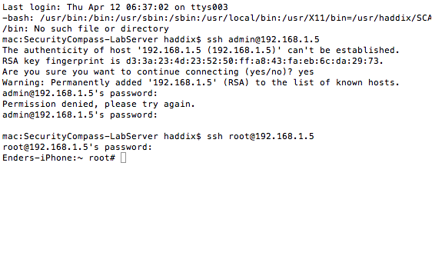
SSH Access

Slide 64
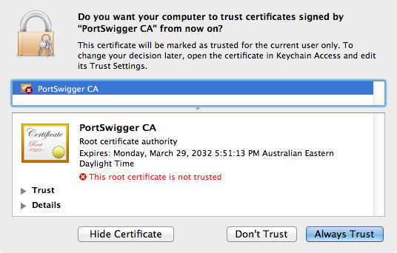
Installing Cert on Device
Export burp .cer file
Email to yourself
access using safari
Accept certificate

Slide 65
Obtain App
BlackBox:
Get from app store or customer ad-hoc distribution:
  App Store binaries are encrypted
    Manual decryption
      Use debugger, breakpoint EP, let loader decrypt, dump decrypted image
        http://dvlabs.tippingpoint.com/blog/2009/03/06/reverse-engineering-iphone-appstore-binaries
        http://pauldotcom.com/wiki/index.php/Episode226
Automated
  Crackulous or AppCrack
  Automate removing DRM
  Can be transferred between devices
Then IDA w/ARM can then disassemble

Slide 66
Identify App Directories
3rd party Applications are stored in:
/private/var/mobile/Applications/$appId/

Slide 67
Parsing Out Server Calls
Strings and grep!
unzip .ipa files
Finds all the strings in the app binary:
  looks for URLs, hostnames, URL parts and function names
  Not exhaustive, whitebox methods give you more.

Slide 68
Monitoring the File System
So what if a file is created for temporary storage and then deleted?
  Mac-robber
“mac-robber is a digital investigation tool that collects data from allocated files in a mounted file system. This is useful during incident response when analyzing a live system or when analyzing a dead system in a lab. The data can be used by the mactime tool in The Sleuth Kit to make a timeline of file activity. Themac-robber tool is based on the grave-robber tool from TCT and is written in C instead of Perl.

Slide 69
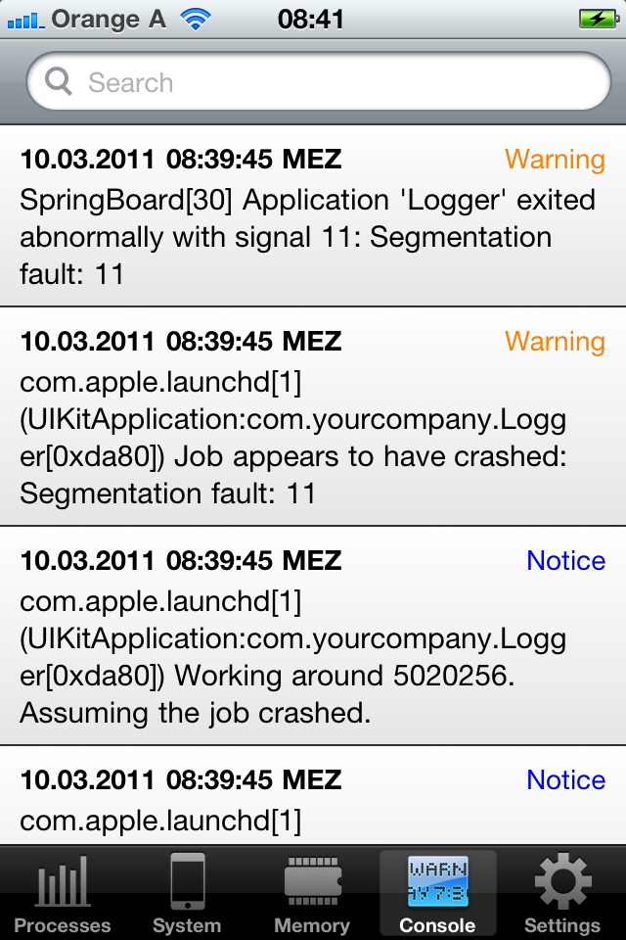
Log Monitoring
You can compile custom C code to interface with apples syslogd (ASL) or…
You can use a $1 app called appswitch
http://goo.gl/XaRQQ

Slide 70
Side Channel Data leakage
All the tests are the same except they now move onto the filesystem of your phone

Slide 71
Mentioning Advanced Testing Techniques
Remote Memory Dumping
  IDA Pro Remote Debugging with GDB
Dumping the iOS Keychain
Mapping Hooking the Objective-C Runtime to bypass security controls
  Class-dump-z
  Cycript
Solving SSL Proxy Issues
  SSL Strip in Burp
  Mallory
  DNS Black holing

Slide 72
Memory Dumping
IDA Supports remote debugging, in options you can setup a remote GDB server
Start GDB on the iphone:
/Developer/usr/bin ./debugserver $IP:port $app
Open in IDA

Slide 73
Keychain Dumper
Dumping the KC:
https://github.com/ptoomey3/Keychain-Dumper
  Compile
  Push keychain_dumper to iOS device
  Use keychain_dumper to export all the required entitlements
  Use ldid to sign these entitlements into keychain_dumper
  Rerun keychain_dumper to dump all accessible keychain items
http://labs.neohapsis.com/2012/01/25/keychain-dumper-updated-for-ios-5/

Slide 74
Cycript
Cycript is an implementation of JavaScript that can interact with Objective-C classes and objects. One of the most useful functions of Cycript is its ability to attach directly to a process, much like gdb, and alter the state of the running application. With Cycript, you can manipulate existing objects already in your application’s memory, or instantiate new objects, such as new view controller classes or windows.
Cycript can access and change instance variables directly, send and intercept messages, access the run loop, override methods, and walk through an object’s internal methods, properties, and instance variables. Cycript can be used to easily hijack and manipulate poorly written applications to bypass authentication screens, circumvent sanity checks, and perform a number of other hacking activities to make an application malfunction
Source: Hacking and Securing iOS Application 2012, Zardinsky

Slide 75
Proxy Issues
We all love Burp BUT you will run into problems sometimes.
  Strict enforcing of SSL
  Crazy iOS and Simulator problems
Downgrade HTTPS to HTTP in burp
    Checkbox under proxy
DNS BlackHoling
What about non HTTP and HTTPS protocols that applications might use?
  Mallory TCP Interception proxy
    http://intrepidusgroup.com/insight/mallory/

Slide 76
Server Side Issues
Server Side:
  Web test / web service test
  We know the web functions
  Try to find the definitions for unpublished ones
  Injections
  Logic Tests

Slide 77
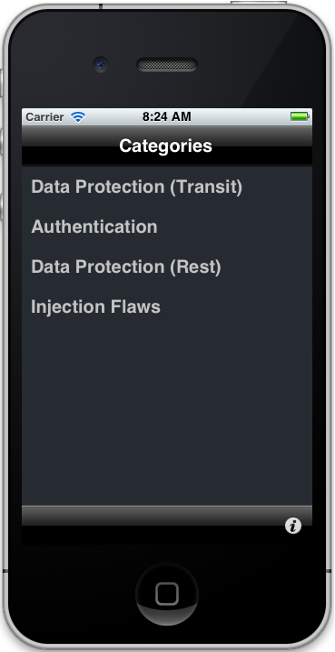
How can you get started?
Most of the simple vulns we have discussed today can be done as examples in OWASPs iGoat Application:
We have added 3 new exercises:
  Format string injection
  Plist data disclosure
  XSS
  Code not in trunk yet =( Will be there soon!
https://www.owasp.org/index.php/OWASP_iGoat_Project

Slide 78
All done! Contact me!
Jason.haddix@hp.com

